Slide 1
MPUs-in-MPLABX-w-MCCH3
Developing bare-metal MCC_Harmony3 applications and debugging in MPLABX
Notes:
v1.2: added mchpDeveloperHelp-starting point for at91 (SL, 24.3.23)
v1.1: after dry1/RobG and 2/MattW (14.3.23)
v1.0: first complete version (SL, 30.1.23)

Slide 2
Class Objectives
Goal of this class is to
Flow to develop MPU applications with MCC-Harmony and debug in MPLABX (20min=15m+5m demo)
different at91 variants needed to (20+20min=40min , no/short demo in 40min)
debug MCCH3 MPU-applications in MPLABX (->let's call variant 'at91_bkptnone') vs
run MCCH3 MPU-applications in production (->let's call variant 'at91_harmony') vs
how to extend and debug second level bootloader at91 in MPLABX
advanced Topics (5min)
Labs (30min, if time)

Slide 3
Agenda
Introduction and flow for MPU-H3-apps-in-X (20min)
How to develop H3 applications for MPUs with MCCH3 + MCC-CM in MPLABX
Demo: LEDtoggle+PRINTF()
MCU vs MPU and how MPUs boot
The second level bootloader at91 and how to create it
Flow for IDE-debugging and production with one MPLABX-prj at91_run.X
at91_ide (->at91_breaknone) for debugging an MPU-MCCH3-application in MPLABX
at91_sdc (->at91_harmony_<nvm>) to use an MPU-MCCH3-application in production and sam-ba
developing/extending at91 in MPLABX -> at91_devel.X
Next step
H3-drv level and middleware apps and graphics -> MPLABpro: MPUs are first devices that are supported
Labs
Lab1: LEDtoggle+PRINTF() -> at91 provided
Lab2a: redo Lab1 but with self-created at91 in MPLABX (->at91_breaknone)
Lab2b1: Lab1 but with self-created at91 from SDCard (->at91_harmony_<nvm>)
Lab2b2: Lab1 but with self-created at91 from any embedded NVM (qspi, emmc, nand) (->at91_harmony_<nvm>)
Lab2c: redo Lab1 but with self-changed at91 from any NVM
Summary

Slide 4
1) Introduction & MPU-H3-in-X flow
First let's see a complete flow how to debug H3-apps for MPUs in MPLABX
Second part is about at91, how it's used
in the MPLABX-based MPU-debug
in the production environment
and, finally how to develop/debug at91 sources itself
Goal for this first demo:
Create simple H3app for SAMA7G54-EK with at91.elf provided ->we'll see in part2 how to create the provided at91.elf ourselves
FW: LEDtoggle@1Hz + UARTout on console + userButton-press=stopExecution
HW setup for different/all MPU-boards
Steps to run demo

Slide 5
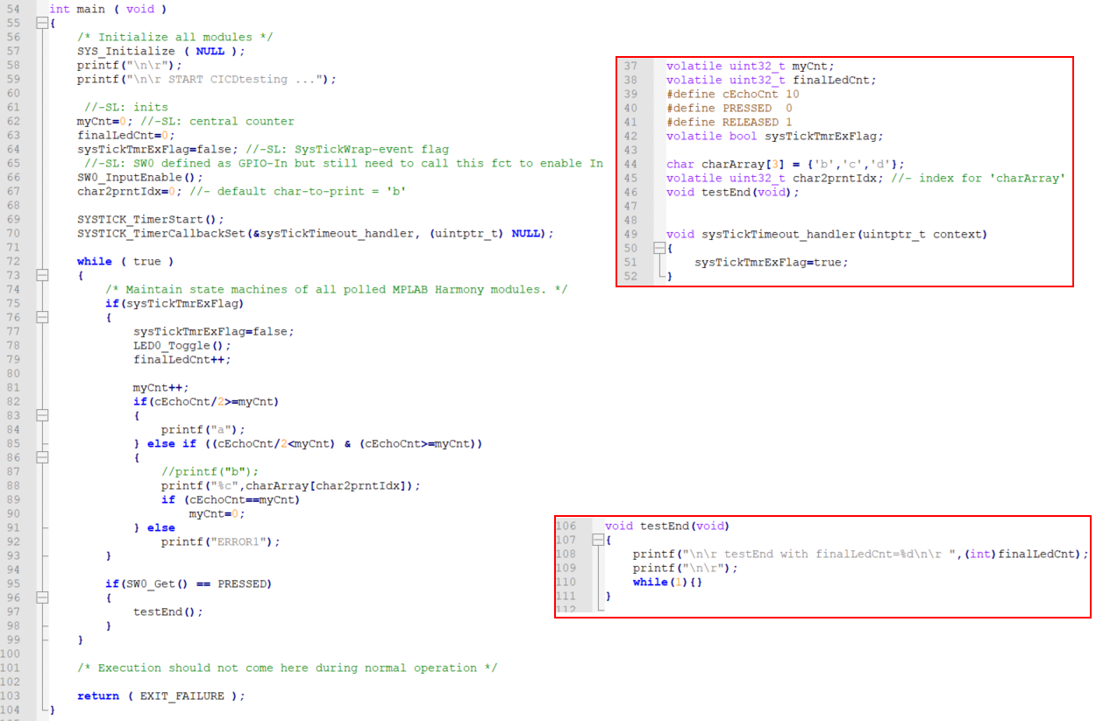
1) used FW
Three FW functionalities:
LED blinks @SYSTICK=250ms
echo a char on uart-console
1.char printed is always 'a'
2.char selected from array charArray with variable char2prntIdx
print 5x1.char/'a' and 5x'2.char/'b,c,d' (default 'b')
=> changing char2prntIdx shows you can control FW behaviour from the script
on HW-button SW0 press FW
jumps to endOfTest()
in endOfTest() print the value of total LEDtoggles stored in finalLedCnt
and loop there

Slide 6
1) Steps to run demo on SAMA7G5-EK
Upfront get infos from DS for SAMA7G5-EK (-> EV21H18A )
LEDpins: GREEN/PA13 , RED/PB8 , BLUE/PD20 (gpioO,H)
onboardDbgVCOM: FLX3, IO0/Tx=PD16 , IO1/Rx=PD17
userButton: PA12 (gpioI, PU)
memoryView: SRAM-start 0x00100000
tools/options/plugins: set H3framework path + ask-flag
new prj -> MCCH3 prj -> H3path -> prj location,name -> H3cfg -> device -> finish
start MCC -> H3 -> all requ.content avail? -> finish
in H3:
add STIO->FLEXCOM3 + System/GenTimer@500ms
pinning from DS (->above)
GenerateCode
project properties
debugger: EDBG jlink -> apply
bootstrap.elf (->Labs\LabHelp\)
XC32-v4.21 (make sure to use v3x+ as v2.50- have a MPU-specific bug -> hardfault!)
test compile -> add main.c (->Labs\LabHelp\) + re-compile
HWreset -> RomBOOT-msg on console? -> if no, check HWsetup !!
debug-download+run -> notice at91- and h3app-printf on the console

Slide 7
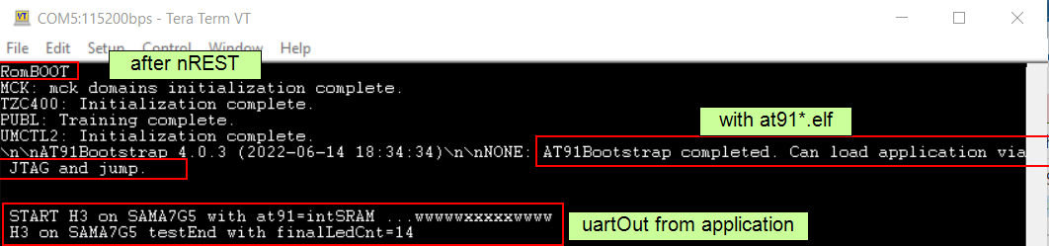
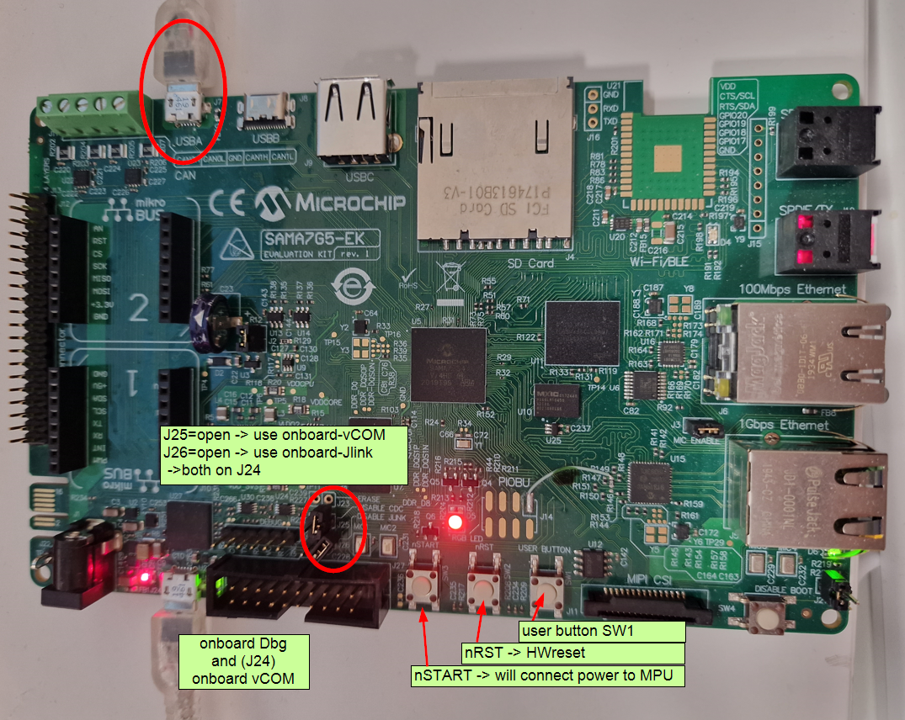
1) expected output for demo on SAMA7-EK

Slide 8
1) Steps to run demo on SAM9x60-curiosity
Demo for a SAM9x60-curiosity
LEDpins: RED/PD17, GREEN/PD19 , BLUE/PD21 (gpioO,H)
onboardDbgVCOM: DBGU, Tx=PA10 , Rx=PA9
userButton: PA29 (gpioI, PU)
tools/options/plugins: set H3framework path + ask-flag
new prj -> MCCH3 prj -> H3path -> prj location,name -> H3cfg -> device -> finish
start MCC -> H3 -> all requ.content avail? -> finish
in H3:
add STIO->DBGU + TC1@500ms
pinning from DS (->above)
GenerateCode
project properties
debugger: EDBG jlink -> apply
bootstrap.elf (->Labs\LabHelp\)
XC32-v4.21 (make sure to use v3x+ as v2.50- have a MPU-specific bug -> hardfault!)
test compile -> add main.c (->Labs\LabHelp\) + re-compile
HWreset -> RomBOOT-msg on console? -> if no, check HWsetup !!
debug-download+run -> notice at91- and h3app-printf on the console
difference MPU vs MCU
next slides = step-by-step
for SAM9x60cur

Slide 9
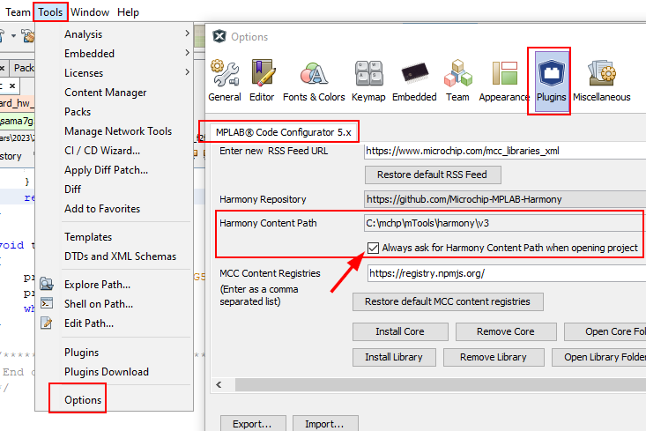
1) step-by-step for SAM9x60-curiosity (1)
Steps to create+run demo on SAM9x60-curiosity ( EV40E67A )
env: MPLABX-v6.05 MCC-plugin-v5.2.2 XC32-v4.21 SAM9X6_DFP-v1.8.201 or SAMA7G5_DFP-v1.1.175
MPLABX-options: make sure to set H3path AND enable 'always ask...'
H3: prepare/manage H3-repos in either MCC-CM or H3-CM or commandline gitbash ...
0

Slide 10
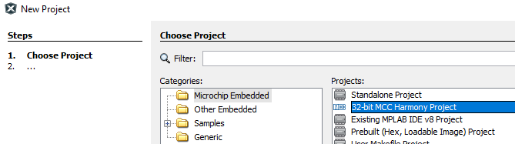
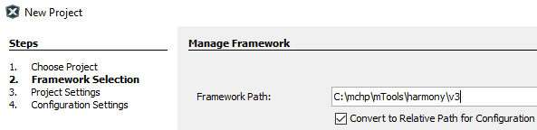
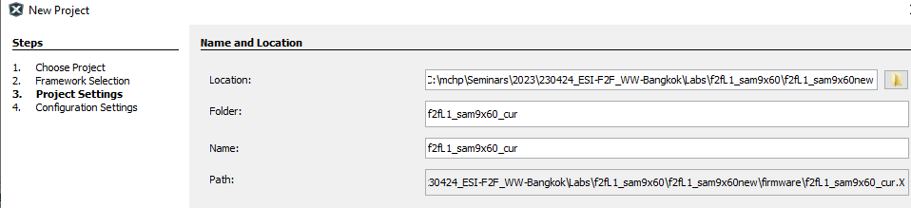
1) step-by-step for SAM9x60-curiosity (2)
Create new MCC-H3 prj (as usual)
1
2
3

Slide 11
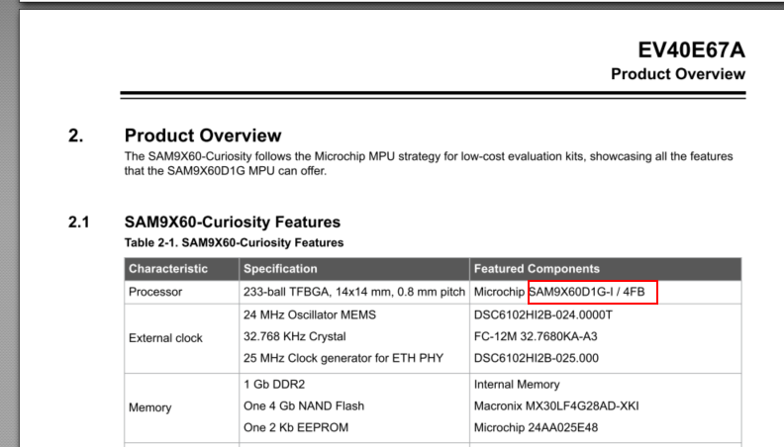
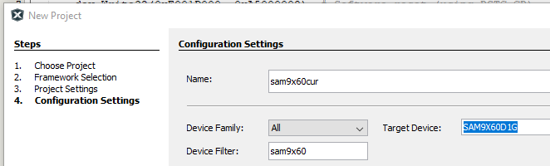
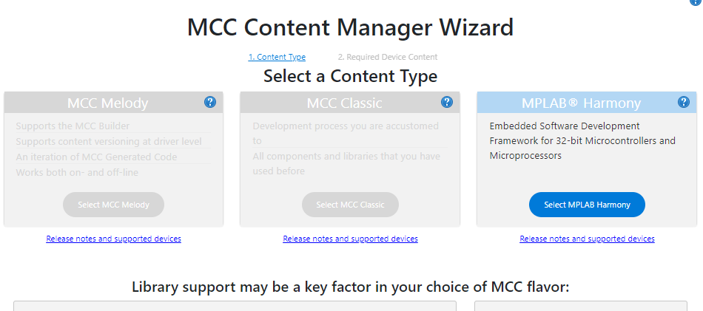
1) step-by-step for SAM9x60-curiosity (3)
Check MPU-version in DS - eg: on the SAM9x60-curiosity is the SIP 'SAM9x60D1G
4
5
6

Slide 12
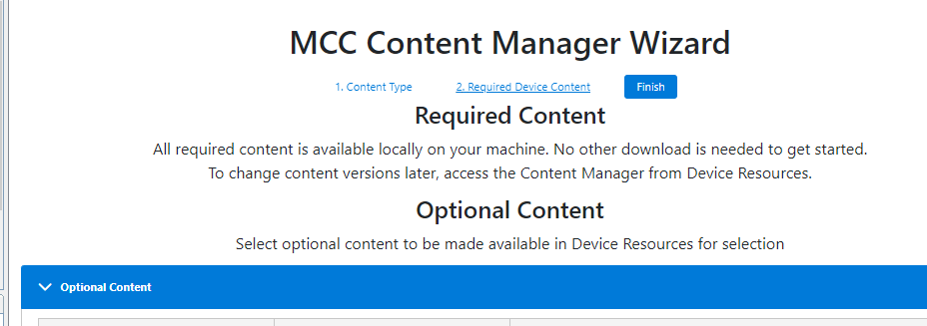
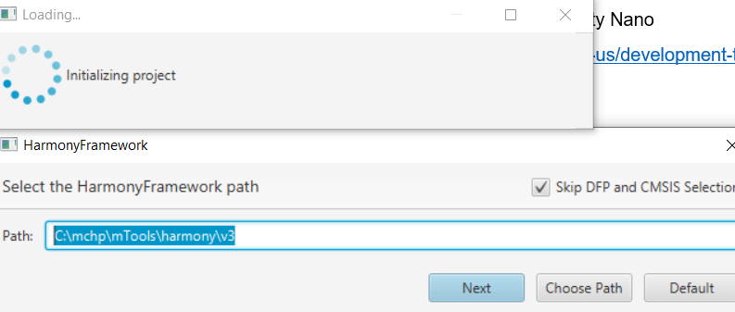
1) step-by-step for SAM9x60-curiosity (4)
Start MCC-H3 and you should see 'all required content available'
7
8

Slide 13
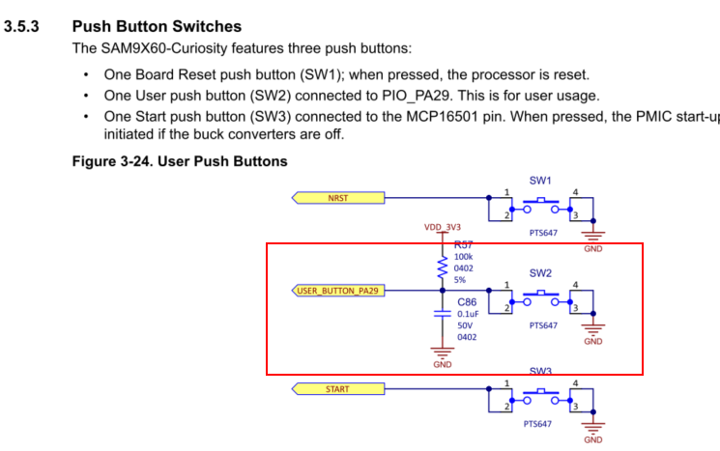
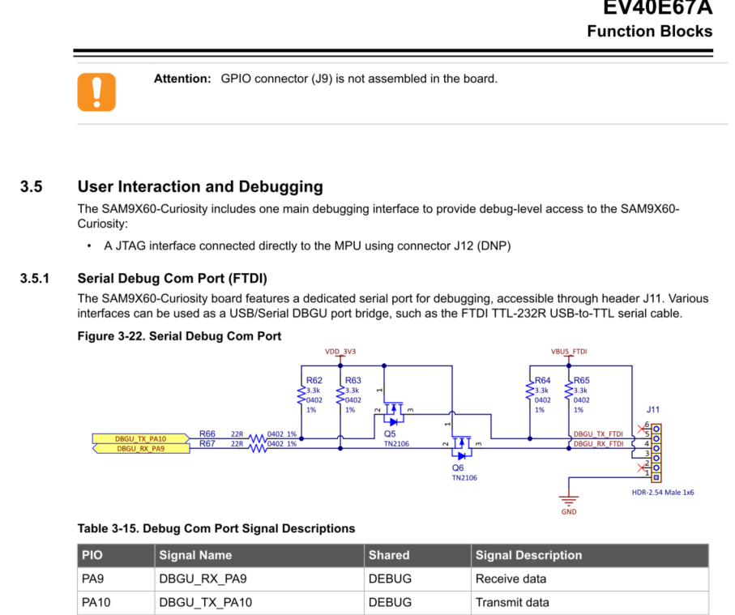
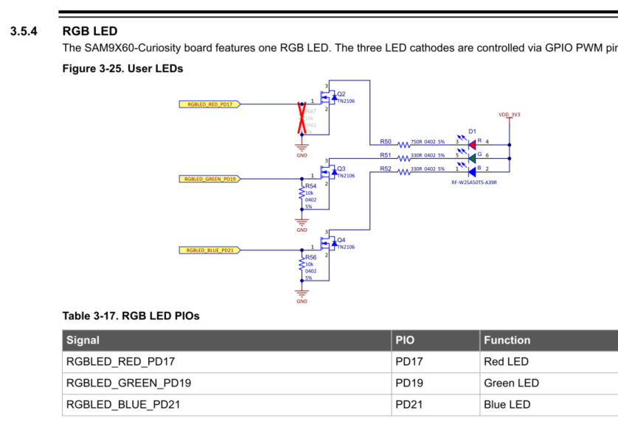
1) step-by-step for SAM9x60-curiosity (5)
Check DS for pinning
9
Pinning SW2 = PA29
LED = R:PD17, G=PD19, B=PD21
vCOM = TX=PA10, RX=PA9 on DBGU

Slide 14
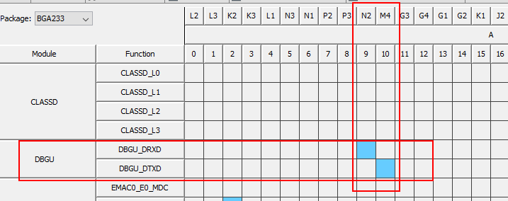
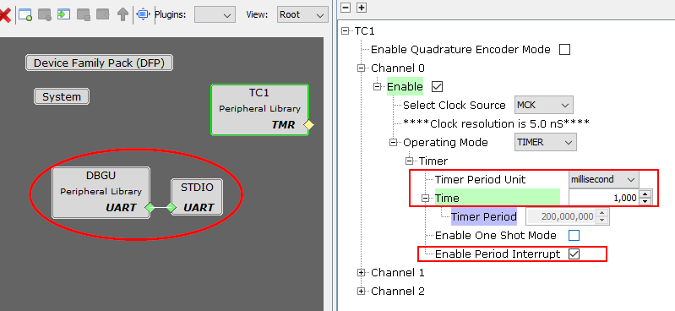
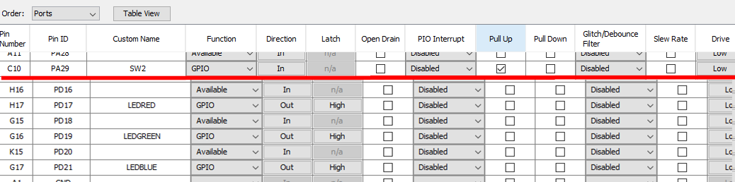
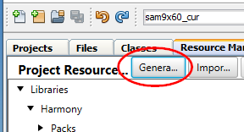
1) step-by-step for SAM9x60-curiosity (6)
10
11

Slide 15
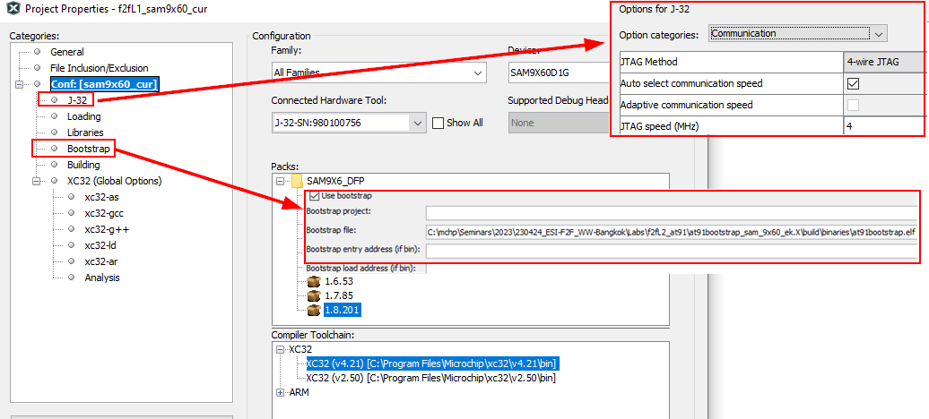
1) step-by-step for SAM9x60-curiosity (7)
Setup prj with J32 & Bootstrap (trick if you don't see 'bootstrap' entry!?)
12
-> from 'LabHelp\'

Slide 16
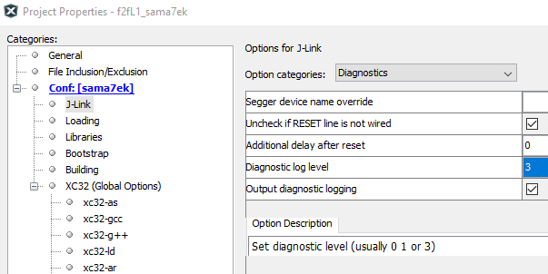
1) step-by-step for SAM9x60-curiosity (7)
additional/helpful diags-echos if needed without messing with python-script
12b

Slide 17
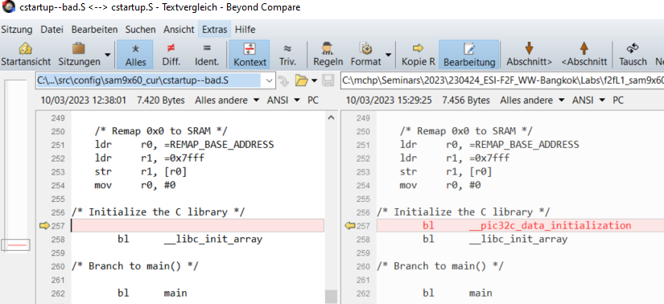
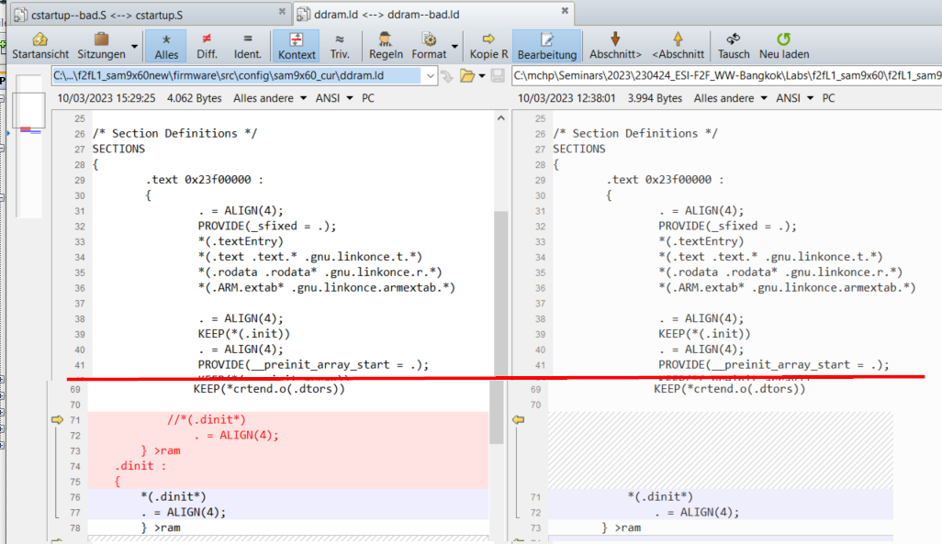
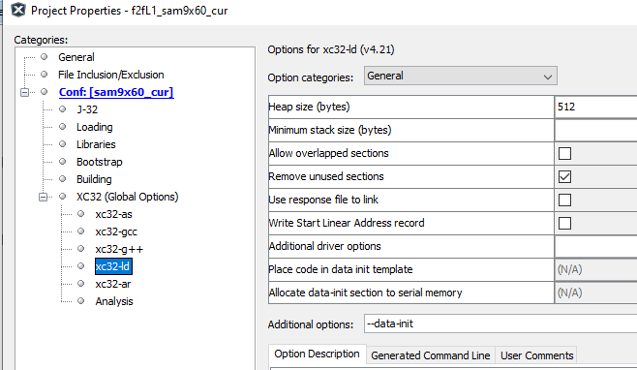
1) step-by-step for SAM9x60-curiosity (8)
MPLABX-v6.05 patches (Jira MPLABX-7342 ->only 9x60!?)
patch ddr.ld-file
add init-step into cstartup.S
add ld-option '--data-init'
13
-> from 'LabHelp\'

Slide 18
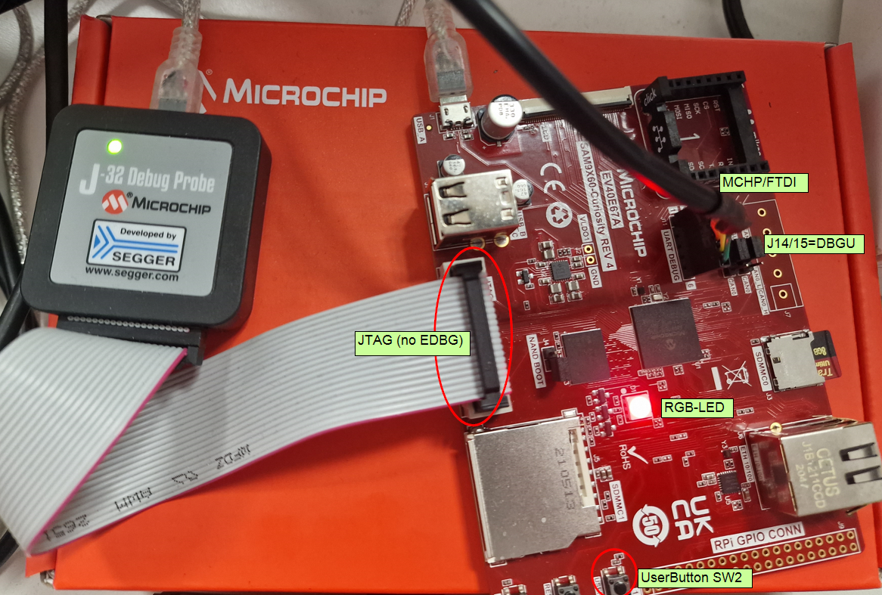
1) step-by-step for SAM9x60-curiosity (9)
14
HW setup

Slide 19
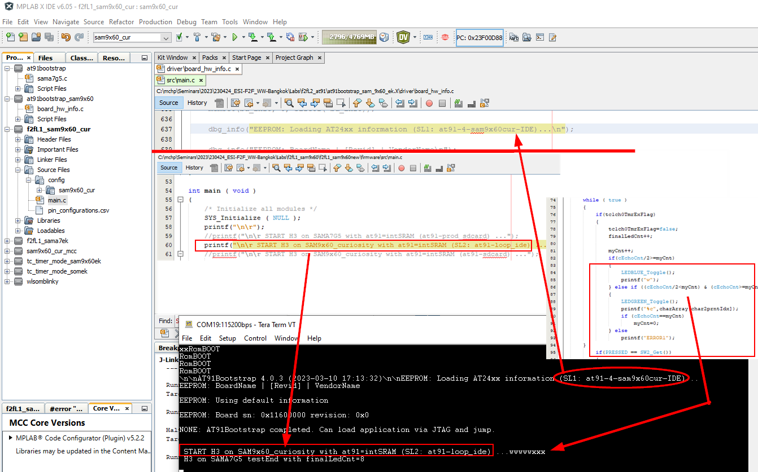
1) step-by-step for SAM9x60-curiosity (10)
messages
15

Slide 20
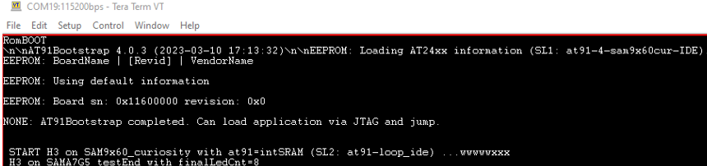
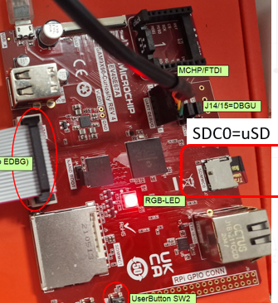
1) expected output on SAM9x60-curiosity (11)
after nReset
at91.elf executes
h3app executes

Slide 21
1) various MPU targets
Next we'll look at various MPU-evalkits and the pitfalls each one holds
SAMA7G5-EK
SAMA5D2-xplained
SOM-EK
WLSOM-EK (with ICD4)
SAM9x60-EK
SAM9x60-curiosity
SAM9x75-ddr3-EB
focus for this session on SAM9x60curiosity -> all other HW-targets are in hidden slides

Slide 22
1) HW-setup for demo using SAMA7G54-EK
Debugger and dbgUart choices
Debugger
use onboard dbg J-Link-OB -> on J24 (microUSB) && Jumper J26=open
use external dbg J32 -> on J27 (JTAG) && Jumper J26=closed
DebugUART
use onboard vCOM -> integrated (no extra cable) in J-Link-OB (J24) && Jumper J25=open
use external vCOM -> extra usb2uart-bridge (eg: FTDI_3v3) on connector DEBUG && Jumper J25=closed
target power
power: on USBA-connector
Obviously different for each MPU-board BUT tested with
SOM-EK ->onboardEDBG provides dbg, vCOM and power -> one microUSB-connection
WLSOM-EK ->usb1 only provides power, need FTDI for vCOM and external debugger
SAM9x60-EK ->onboardEDBG and vCOM on usb1 and power on usb2
SAM9x60-cur ->no onboardDbg, nor vCOM, hence need extJ32+FDTI
SAM9x70-EK ->not tested yet

Slide 23
1) HW-setup for demo with SAMA7G-EK
_

Slide 24
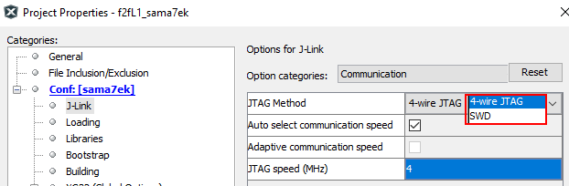
1) SAMA7G5-EK (works)
SAMA7G5-EK xplained
HW setup
Jumpers !!
nSTART (=pwr button !)
Prj f2fL1_sama7ek.X
env
MPLABX-v6.05.03.6758
XC32-v4.21
SAMA5D2_DFP
(CMSIS-v?? - incl in DFP??)
DFP-v1.7.172
Dbg
typ: EDBG/Jlink
IF: SWD & JTAG (both work!!)
speed: 4MHz

Slide 25
1) various MPU targets
next we'll look at various MPU-evalkits and the pitfalls each one holds
SAMA7G5-EK
SAMA5D2-xplained
SOM-EK
WLSOM-EK
SAM9x60-EK
SAM9x60-curiosity
SAM9x75-ddr3-EB

Slide 26
1) SAMA5D2* xplained (-)
1-20m
SAMA5D2* xplained
HW setup
Jumpers !!
not nSTART (=pwr button)
Prj tc_timer_mode-somek
env
MPLABX-v??
XC32-v??
SAMA5D2_DFP (CMSIS-v5.8.0)
v??
->so once you have a working env note versions and picture of setup (which connections and jumpers are needed !)
tested before, but not with latest setup

Slide 27
1) various MPU targets
next we'll look at various MPU-evalkits and the pitfalls each one holds
SAMA7G5-EK
SAMA5D2-xplained
SOM-EK
WLSOM-EK
SAM9x60-EK
SAM9x60-curiosity
SAM9x75-ddr3-EB

Slide 28
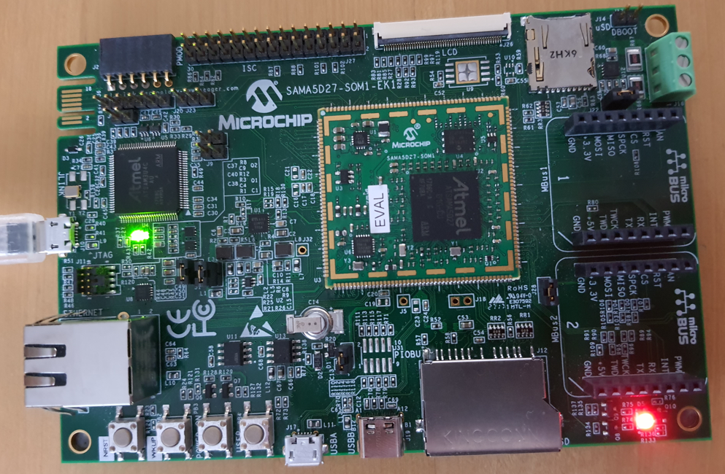
1) SAMA5D2* SOM-EK (works)
SAMA5D2* SOM-EK
HW setup
Jumpers !!
not nSTART (=pwr button)
Prj tc_timer_mode-somek
env
MPLABX-v6.05.03.6758
XC32-v4.21 (v2.50 crashes in hard-fault -> v2.50-bug)
SAMA5D2_DFP (CMSIS-v5.8.0)
v1.7.91 works
v1.9.108 (latest) crashes !!
->so once you have a working env note versions and picture of setup (which connections and jumpers are needed !)

Slide 29
1) various MPU targets
next we'll look at various MPU-evalkits and the pitfalls each one holds
SAMA7G5-EK
SAMA5D2-xplained
SOM-EK
WLSOM-EK
SAM9x60-EK
SAM9x60-curiosity
SAM9x75-ddr3-EB

Slide 30
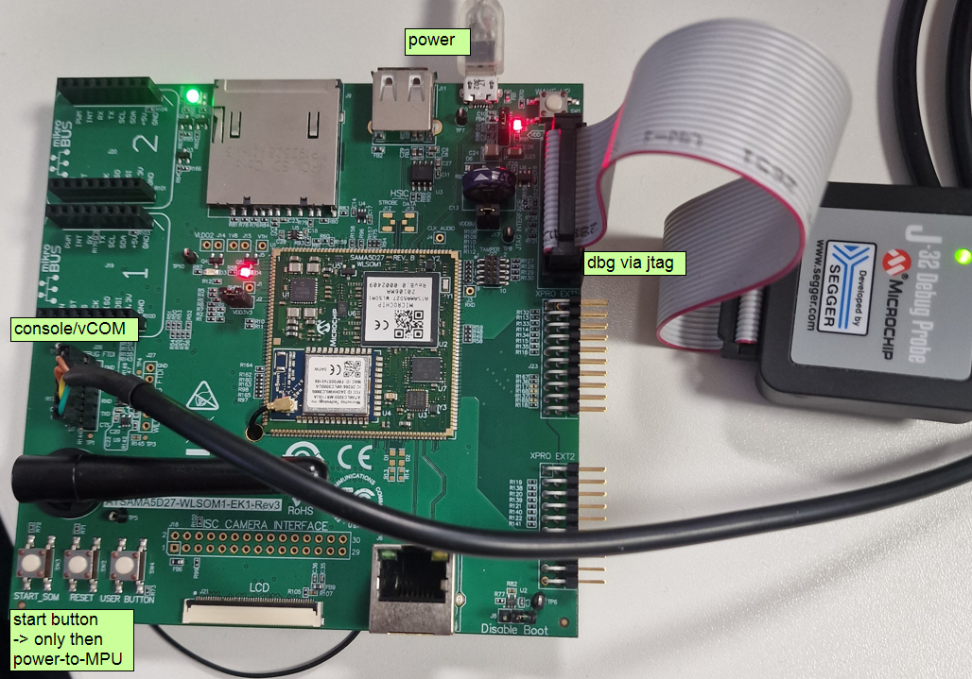
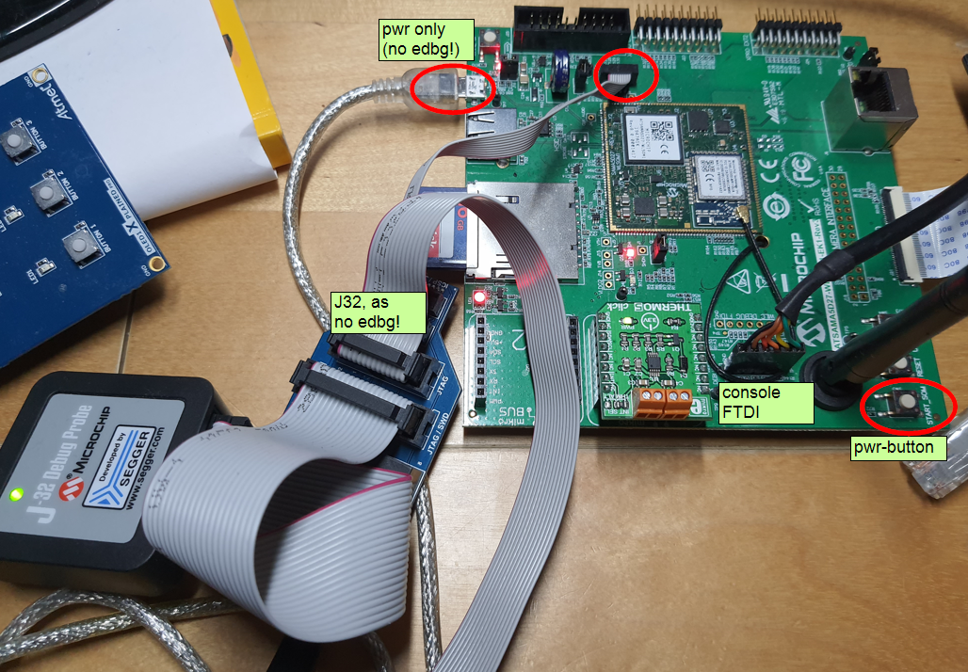
1) SAMA5D2* WLSOM-EK (works)
SAMA5D2* WLSOM-EK
HW setup
Jumpers !!
nSTART to route pwr-2-MPU
no EDBG, need J32
Prj wlsomblinky
env
MPLABX-v6.05.03.6758
XC32-v4.21 (v2.50 crashes)
SAMA5D2_DFP (cmsis-v5.8.0)
v1.9.108 works
dbgComIF 4w-JTAG
->so once you have a working environment note down versions and picture of setup (which connections and jumpers are needed !)

Slide 31
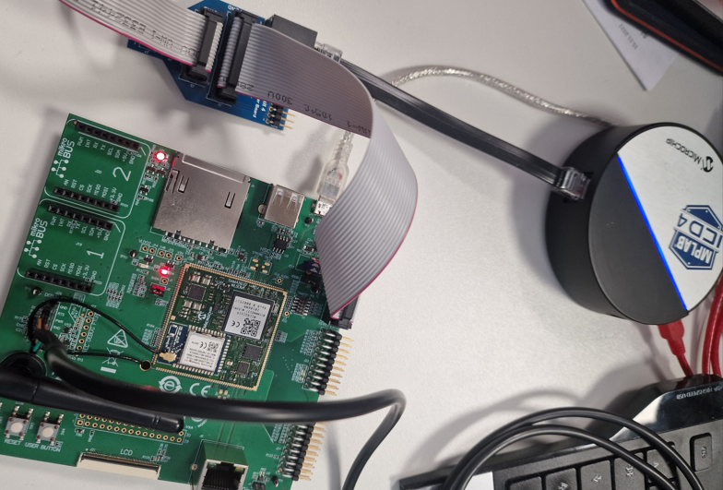
1) SAMA5D2* WLSOM-EK + Gen4-ICD4 (works)
SAMA5D2* WLSOM-EK
HW setup
Jumpers !!
nSTART to route pwr-2-MPU
no EDBG ->Gen4-tools
Prj wlsomblinky
env
MPLABX-v6.05 (-> beta *.03.6758 crashes)
XC32-v4.21 (v2.50 crashes)
ICD4 -> works
TP-v1.13.1671
SAMA5D2_DFP
DFP-v1.9.106
cmsis-v5.8.0
dbgComIF: JTAG
->once you've a working environment note down versions and picture of setup (connections, jumpers)
we'll learn later how to find out which Dbg is supported for your MPU-HW

Slide 32
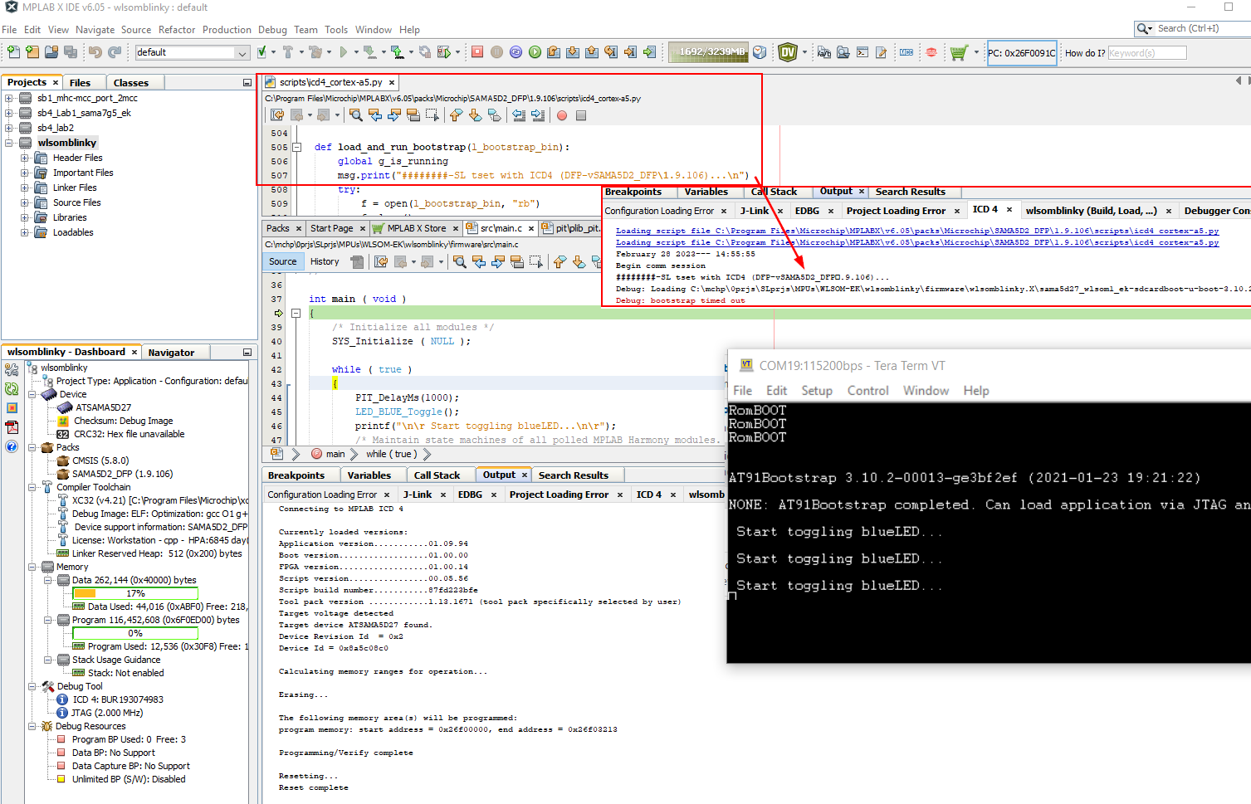
1) SAMA5D2* WLSOM-EK + Gen4-ICD4 (works)
expected result with ICD4 (!works!)

Slide 33
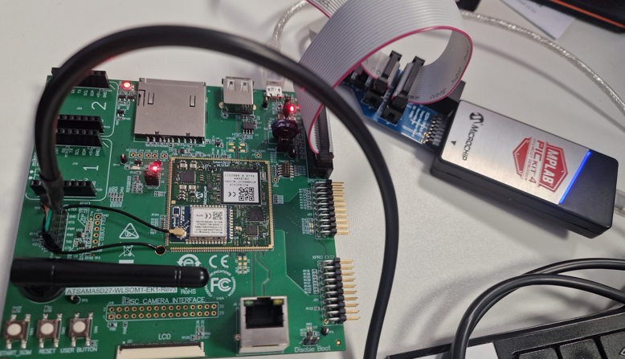
1) SAMA5D2* WLSOM-EK + Gen4-Pickit4 (fails)
SAMA5D2* WLSOM-EK
HW setup
Jumpers !!
nSTART to route pwr-2-MPU
no EDBG ->Gen4, next slide
Prj wlsomblinky
env
MPLABX-v6.05 (-> beta *.03.6758 crashes)
XC32-v4.21 (v2.50 crashes)
Pickit4 -> works
TP-v1.15.1682
SAMA5D2_DFP
DFP-v1.9.106
cmsis-v5.8.0
dbgComIF: JTAG
->once you've a working environment note down versions and picture of setup (connections, jumpers)

Slide 34
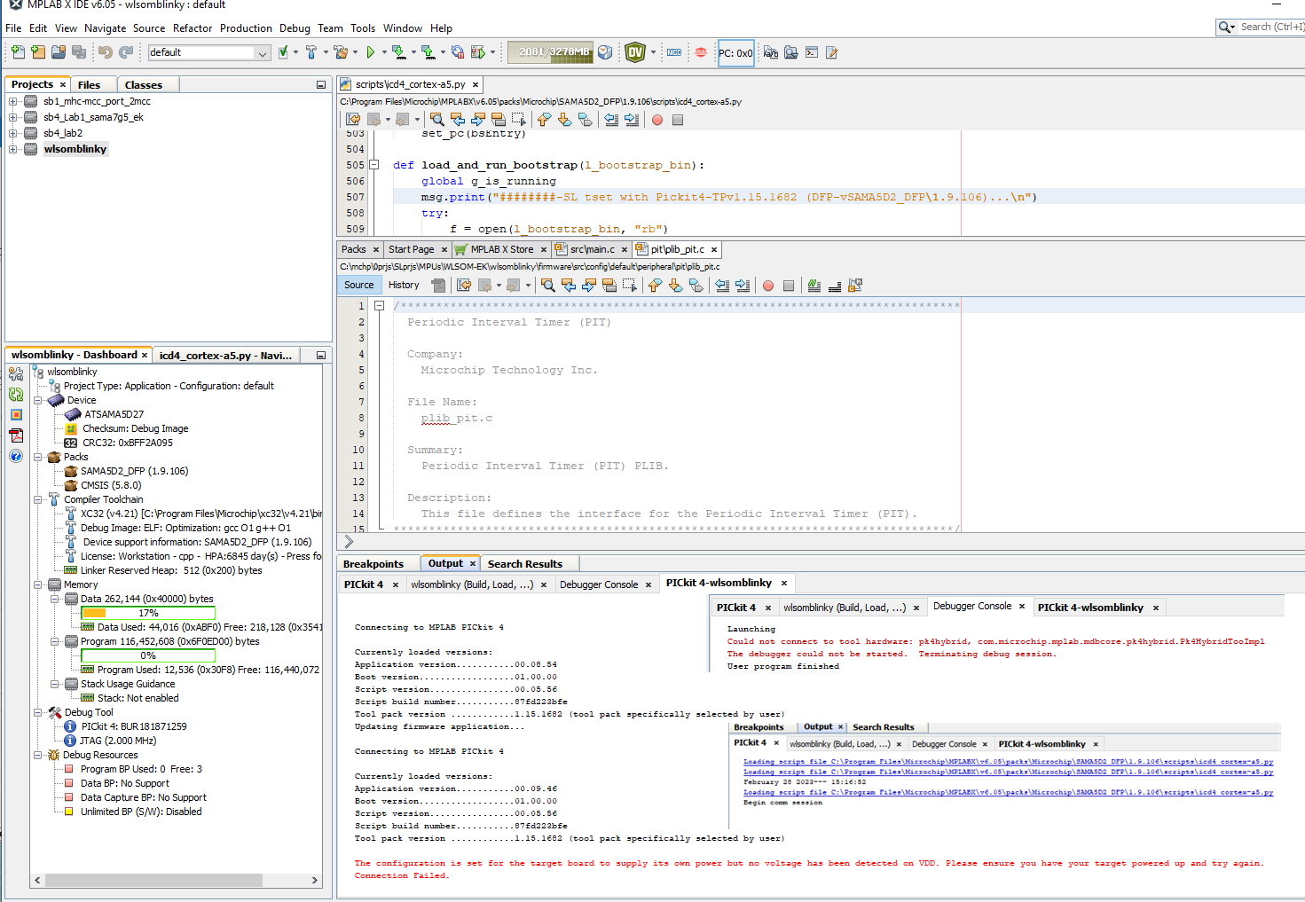
1) SAMA5D2* WLSOM-EK + Gen4-Pickit4 (fails)
expected result with ICD4 (!does NOT works!)

Slide 35
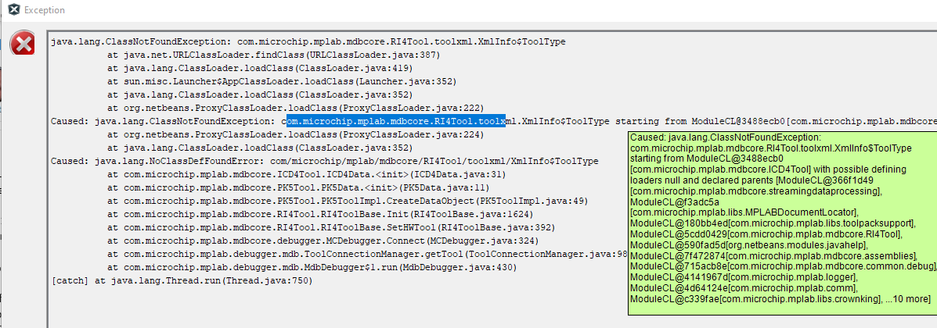
1) SAMA5D2* WLSOM-EK + Gen5-Pickit5 (fails)
expected result with ICD4 (!does NOT works!)

Slide 36
1) various MPU targets
next we'll look at various MPU-evalkits and the pitfalls each one holds
SAMA7G5-EK
SAMA5D2-xplained
SOM-EK
WLSOM-EK
SAM9x60-EK
SAM9x60-curiosity
SAM9x75-ddr3-EB

Slide 37
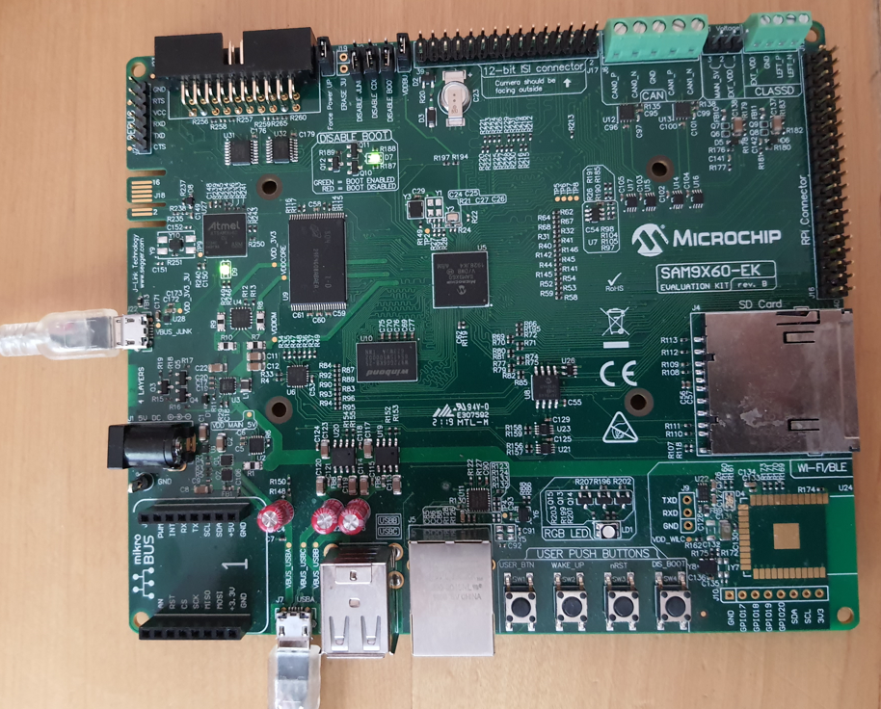
1) SAM9x60-EK (works)
SAM9x60-EK
HW setup
Jumpers !!
not nSTART (=pwr button)
Prj tc_timer_mode-sam_9x60_ek_xc32
env
MPLABX-v6.05.03.6758
XC32-v4.21 (v2.50 crashes in hard-fault -> v2.50-bug)
SAMA9x6_DFP (CMSIS-v5.8.0)
v1.8.201 (latest) works
->so once you have a working env note versions and picture of setup (which connections and jumpers are needed !)

Slide 38
1) various MPU targets
next we'll look at various MPU-evalkits and the pitfalls each one holds
SAMA7G5-EK
SAMA5D2-xplained
SOM-EK
WLSOM-EK
SAM9x60-EK
SAM9x60-EK (focus for this session - rest hidden slides)
SAM9x75-ddr3-EB

Slide 39
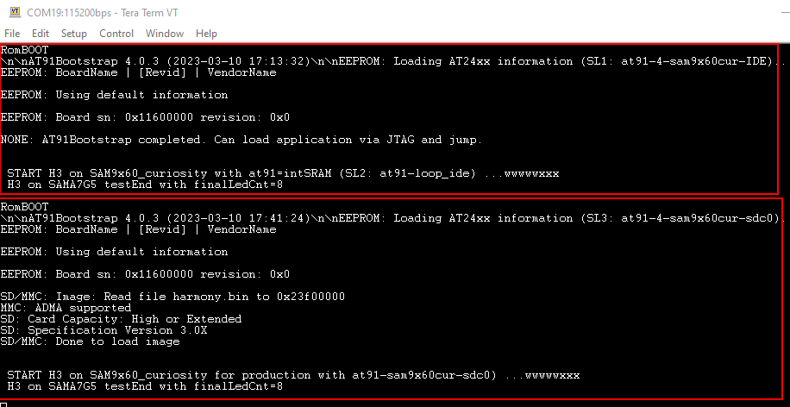
1) SAM9x60-curiosity (-)
SAMA9x60 curiosity
HW setup ( EV40E67A )
J14/15 = DBGU
nSTART (=pwr button)
Prj: f2fL1_sam9x60new
env
MPLABX-v6.05 (MCC-v5.2.2) (with patches cstartup, ld-file, ld-opt !?)
XC32-v4.21
SAMA9x6_ DFP-v1.8.201
->so once you have a working environment note versions and picture of setup (which connections and jumpers are needed !)

Slide 40
1) various MPU targets
next we'll look at various MPU-evalkits and the pitfalls each one holds
SAMA7G5-EK
SAMA5D2-xplained
SOM-EK
WLSOM-EK
SAM9x60-EK
SAM9x60-curiosity
SAM9x75-ddr3-EB

Slide 41
1) SAM9x75-EB (-)
SAMA9x75 EB
SAM9x60-curiosity
SAM9x75-ddr3-EB
HW setup
Jumpers !!
not nSTART (=pwr button)
Prj -
env
MPLABX-v??
XC32-v??
SAMA9x7_DFP (CMSIS-v5.8.0)
v??
->so once you have a working env note versions and picture of setup (which connections and jumpers are needed !)
not tested yet

Slide 42
1) Various targets - what's the message here?
Don't trust if someone tells you 'it works' or 'should work' -> test yourself, verify AND once you've a working setup !!! note down versions+phy- setup !!!

Slide 43
DEMO
DEMO on
SAM9x60-curiosity or SAMA7G5-EK with provided at91.elf
or skip ?!
Notes:
!!! if time<=15min run demo otherwise skip
!!! prepared demo just loaded=5min -> from-scatch=10min

Slide 44
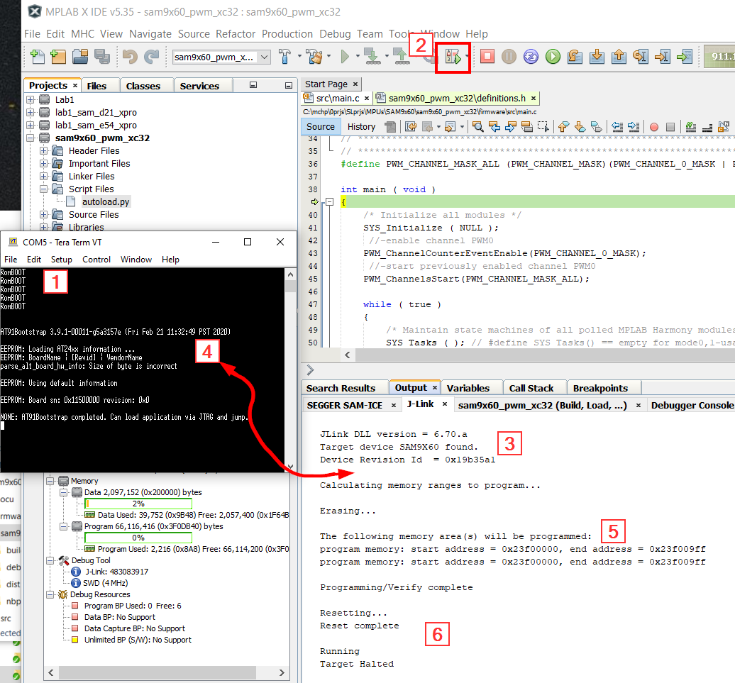
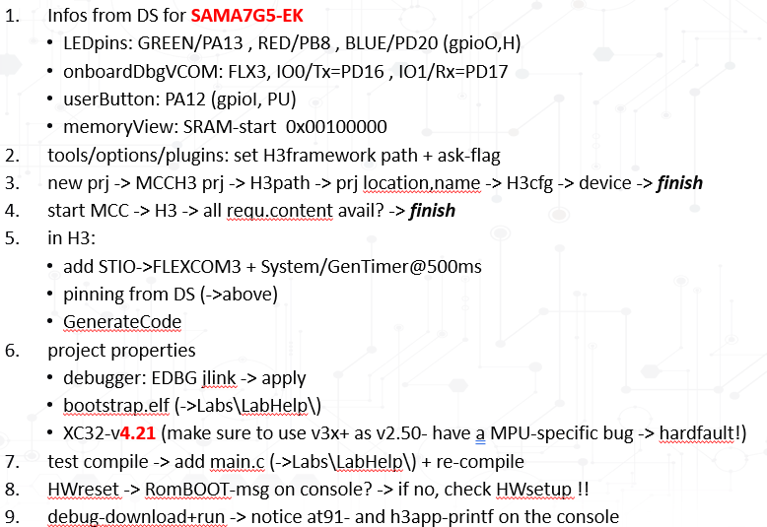
1) summary of steps to run demo on SAMA7G5
Demo
Steps to create+run a MPU-H3app
Obviously at91 gets executed, but how?
Following slides will show how at91 is triggered

Slide 45
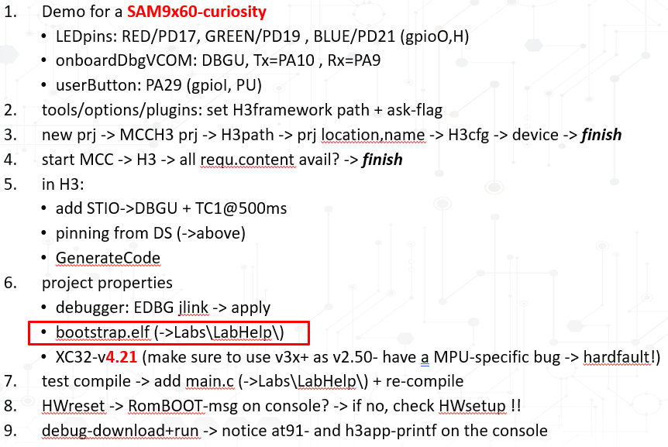
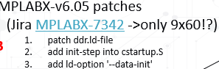
1) summary of steps to run demo on SAM9x60cur
Demo
Steps to create+run a MPU-H3app
Obviously at91 gets executed, but how? -> following slides show how at91 is triggered
Ran into HardFault?
don't forget to re-compile!
no output? -> baudrate set correctly in plib_dbgu.c ?

Slide 46
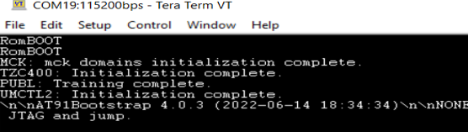
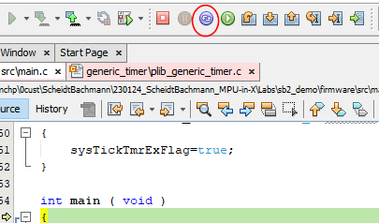
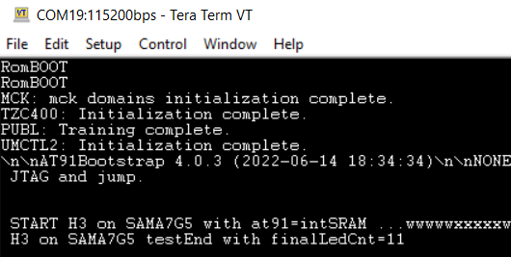
2) 'a' proper MPU-debug flow
Before we look into how at91 was run, short remark on how to properly debug MPUs in MPLABX:
in MPLABX setup prjProp with at91_dbg.elf -> open console -> press HW-reset -> make sure to see RomBOOT msg
on debugDownload make sure you see at91-execution message on console
use breakpoints, singlestep,... just like normal
don't use RESET-button in the IDE but instead
end debug-session with
press HW-reset on the board -> RomBOOT-msg on console !!
re-download and restart
why?
-> the IDE-reset only reset PC=resetVector, whereas for MPUs it would need to set PC=startApp-in-DDR

Slide 47
Agenda
Introduction and flow for MPU-H3-apps-in-X
How to develop H3 applications for MPUs with MCCH3 + MCC-CM in MPLABX
Demo: LEDtoggle+PRINTF()
MCU vs MPU and how MPUs boot
The second level bootloader at91 and how to create it (40min)
Flow for IDE-debugging and production with one MPLABX-prj at91_run.X
at91_ide (->at91_breaknone) for debugging an MPU-MCCH3-application in MPLABX
at91_sdc (->at91_harmony_<nvm>) to use an MPU-MCCH3-application in production and sam-ba
developing/extending at91 in MPLABX -> at91_devel.X
Next step
H3-drv level and middleware apps and graphics -> MPLABpro: MPUs are first devices that are supported
Labs
Lab1: LEDtoggle+PRINTF() -> at91 provided
Lab2a: redo Lab1 but with self-created at91 in MPLABX (->at91_breaknone)
Lab2b1: Lab1 but with self-created at91 from SDCard (->at91_harmony_<nvm>)
Lab2b2: Lab1 but with self-created at91 from any embedded NVM (qspi, emmc, nand) (->at91_harmony_<nvm>)
Lab2c: redo Lab1 but with self-changed at91 from any NVM
Summary
Notes:
goal to start this after 20min and this section ~40m

Slide 48
2) Resume: steps to create a H3-app and debug in MPLABX
41-60m
To summarize: to create a H3-application and debug it in MPLABX the steps are
set path-to-H3framework in Tools/Options/Plugins/MCC + set ask-flag
create new MCC-H3-prj as usual and select MPU
start MCC -> best is to make sure all required content is loaded or use MCC-CM to get/update repos
add functionality/modules in MCC-MHC3 UI -> generate code
set project properties
select debugger (->trick 'show all' - later slide)
bootstrap infos (3 choices: at91-prj or at91.elf or at91.bin + entry&load-addr) -> at91*.elf provided
XC32-v3.x (before like v2.50 had MPU-specific bug that leads to hard_fault on exec)
add application and compile
setup HW, connect console and make sure you see RomBOOT (!? nSTART-button??)
now dbg-download and notice at91-output on console -> IDE uses DFP\python.scr (details follow!!) to
extracts at91-name + path and entry/load-address infos from prjProp entry 'bootstrap'
loads at91 into intSRAM and executes it ->one at91-task is to setup the DDR
somehow control is given back to IDE to download h3app linked to ddr as in usual MCU-flow
once h3app is downloaded into DDR, the PC is set to h3app_main() and break or run (->tools/options)
the IDEreset button only resets PC but doesn't re-run at91, therefore popup warning and not recommended

Slide 49
2) Summary: review of demo-steps
What did we do in the demo?
=> just created a normal H3app with MCC
What happened in the background?
=> somehow the at91 got executed, but how?
Which memories does the MPU have and what's available after reset?
=> after releasing reset only visible MPU-internal memory is the intSRAM
where did the at91 run from and how was it downloaded?
=> only MPU-memory it can run from is intSRAM, but how was is downloaded+executed
->need some mechanism to download at91 into intSRAM+execute
What is the at91 doing anyway?
=> besides other tasks that at91 initializes the DDR, so it can be used to store+execute code
Where did the application execute?
=> ddr.ld links H3app to DDR, but how was it downloaded?
How did h3app get loaded into DDR?
=> after at91 ran, DDR-space now visible, hence IDE can just download as 'usual'

Slide 50
2) Resume: steps to create a H3-app and debug in MPLABX
41-60m
To summarize: to create a H3-application and debug it in MPLABX the steps are
set path-to-H3framework in Tools/Options/Plugins/MCC + set ask-flag
create new MCC-H3-prj as usual and select MPU
start MCC -> best is to make sure all required content is loaded or use MCC-CM to get/update repos
add functionality/modules in MCC-MHC3 UI -> generate code
set project properties
select debugger (->trick 'show all' - later slide)
bootstrap infos (3 choices: at91-prj or at91.elf or at91.bin + entry&load-addr) -> at91*.elf provided
XC32-v3.x (before like v2.50 had MPU-specific bug that leads to hard_fault on exec)
add application and compile
setup HW, connect console and make sure you see RomBOOT (!? nSTART-button??)
now hit IDE dbg-download and notice at91-output on console -> IDE needs some means to download at91 into internalSRAM and execute it -> next section
once at91 executed DDR-space now visible, hence IDE can just download app as usual in MCU-flow and halt@main (if configured)
IDEreset button only resets PC but doesn't re-run at91, therefore popup warning and not recommended

Slide 51
2) how MPUs boot and task of at91
41-60m
Before we look at how at91 is runs, to debug a H3 app in MPLABX, need to understand how MPUs boot?
Valid boot code
ROMCode
ROMCode
Bootstrap
In summary:
Applications for MPUs run out-of DDR
But DDR is setup by at91, hence must first run at91 and only after can load & execute the application
Run from DDR is the usual flow but one can also configure the system to run from eg QSPI with XIP mode and would completely skip DDR ->later slide !
Bootstrap
Application
Application
DRAM
Application
ROM Memory
Bootstrap
Bootstrap
NVM
SRAM Memory
SAMA5
Is being executed

Slide 52
2) at91 for H3app develop in MPLABX
41-60m
Variant needs to support develop&debug of a Harmony3-application in MPLABX
at91 tasks for this case are:
all at91-tasks like configure PLLs and setup DDR
finally, just loop@end (->at91_breaknone)
Before we see how to create this at91-variant in MPLABX, first let's look at how the flow in MPLABX works

Slide 53
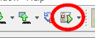

2) MPU-specifics: at91 for H3-dbg in X
41-60m
What happens in the background when you hit 'Download' in the IDE?
3: releaseRST
2:IDE-download: compile h3app.elf
1: h3app.X prjProp
ROM
Bootstrap ->at91*.elf
RomBOOT msg?
Rom -> no at91? ->sam-ba mode
NVM
4:<dfp>\scripts\jlink*.py: download at91_loopEnd to intSRAM + execute
intSRAM
at91
5: after timeout IDE continues as usual
6: MDBCore/IDE: progr_wr() h3app.elf into DDR (as usual)
loop
SAMA7
h3_app.bin
7: jump main() and run
DDR
system

Slide 54
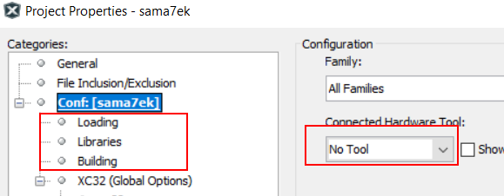
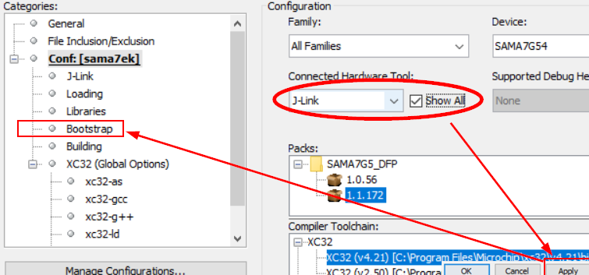
2) specifying at91 in MPLABX projectProps
41-60m
Entry 'bootstrap' in prjProps not visible?
only visible if a debugger that supports MPUs is selected
either connect EDBG/J32 or select via 'Show All' + apply

Slide 55
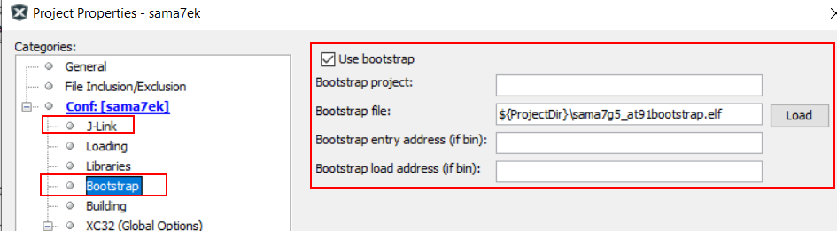
2) specifying at91 in MPLABX projectProps
41-60m
bootstrap in MPLABX project properties:
use bootstrap 'enable' (why this choice is unclear)
3 choices
path to bootstrap project (never tried to use at91…X prj)
use elf-version of at91 (contains entry-&load-address, so *.elf enough)
use bin-version of at91, but then need to specify entry- and load-address (-> next slide)

Slide 56



2) at91 elf vs bin
41-60m
SAMA7G5

Slide 57

2) download+execute at91
41-60m
now know where at91 bootstrap is specified but how is it downloaded into SRAM and executed?
Trick is a python-interface introduced with MPLABX-v5.25 (MPU support was one reason)
With this python-IF all MDBCore functionality is available in python
So, if target=MPU MPLABX loads+executes <DFP>\<mpu>\<version>\scripts\*.py when you hit Download
Let's take a closer look

Slide 58
2) DFP-python script for at91 (1)
41-60m
required python-files are from <packs>\<yourArch>\<version>\scripts\<dbg>_<arch>.py eg: <packs>\SAMA7G5_DFP\1.0.56\scripts\j-link_cortex-a7.py
recap from flow on what needs to be done?
-> 1:releaseReset -> 2:download specified at91 into intSRAM -> 3:execute -> 4:give control back to IDE
let's see the relevant parts in the script next -> rest is self-explanatory

Slide 59


2) DFP-python script for at91 (2)
41-60m
MPLABX -> MDBcore -> python
re-use MDBCore where possible -> '#mplab' indicates native MDBCore-function
In the 'normal' MCU-flow MDBCore downloads app.elf into MCU-flash on click
fct 'overloading' - eg: def prog_write() [-> MDBCore] vs _prog_write() [-> python]

Slide 60

2) DFP-python script for at91 (3)
41-60m
User infos on Bootstrap are handled here:
from DFP
Infos from prjProgs 'bootstrap' are extracted in 'class BootstrapPane():'

Slide 61


2) DFP-python script for at91 (4)
41-60m
Function 'def load_file_and_pc(binary_path)' to load at91 and set PC=at91_main()
DFP
to load-at91 & set PC
if at91.elf/hex is provide, it contains entry-+load-addr BUT for at91.bin also need entry- + load-addr
set PC=at91_main() =entry-address
Notes:
from <packs<\SAMA7G5_DFP\1.0.56\scripts\j-link_cortex-a7.py

Slide 62

2) DFP-python script for at91 (5)
41-60m
All starts with function 'def load_and_run_bootstrap(l_bootstrap_bin)' to load at91 + execute
from DFP
to load & exec at91 (l_bootstrap_bin -> class BootstrapPane():)
use 'load_file_and_pc()' == "load at91 + set PC=at91_main()" ->provious slide
execute at91 using MDBCore-object reference 'deb'
here's where script gives control back to IDE after a timeout
Notes:
from <packs<\SAMA7G5_DFP\1.0.56\scripts\j-link_cortex-a7.py

Slide 63
BREAK
41-60m
BREAK

Slide 64
2) summary: DFP-python script for at91
41-60m
<packs<\SAMA7G5_DFP\1.0.56\scripts\j-link_cortex-a7.py
review only major functions as rest is self-explanatory
recap: what needs to be done?
1:releaseReset -> 2:download specified at91 into intSRAM -> 3:execute -> 4:give control back to IDE
all starts with def load_and_run_bootstrap(l_bootstrap_bin)
need to somehow extract the infos provided in prjProp on at91 -> class BootstrapPane()
release reset -> def release_from_reset(): #mplab (!!MDBCore-fct -> fct overloading !!)
download at91 from host (->prjProp/bootstrap-entry) into intSRAM and set PC=at91_main() -> def load_file_and_pc(binary_path) with binary_path -> prjProp/bootstrap-entry
and then downloads at91 byte-by-byte load_binary_file()
and also sets PC -> set_pc(bsEntry) with bsEntry either
from elf (… if "elf" == filetype: …) via MDBCore-fct deb.PeekSymbolAddress() -> 'deb' is a MDBCore-class exported to python -> MPLABX SDK !!
or from prjProp/bootstrap-entry if at91.bin specfied
and finally execute downloaded at91 -> dev.GoEx(1,1) -> MDBCore-functionality
what's left?
->must give control back to IDE to download h3app into DDR, as in usual MCU-flow -> timeout

Slide 65
2) MPUs and supporting debuggers
41-60m
Debuggers and MPUs - who supports what?
SAMA7: <X-v6.05>\packs\Microchip\SAMA7G5_DFP\1.0.56\scripts\
j-link_cortex-a7.py -> SAMA7 supported in MPLABX-v6.05 with Jlink + J32
- -> not yet supported by Gen4-tools (pickit4, icd4, ice4)
SAMA5D*: <X-v6.05>\packs\Microchip\SAMA5D2_DFP\1.9.106\scripts\
j-link_cortex-a5.py -> SAMA5D* supported in MPLABX-v6.05 with Jlink + J32
icd4_cortex-a5.py -> SAMA5D* supported in MPLABX-v6.05 with ICD4-tools
SAM9x6: <X-v6.05>\packs\Microchip\SAM9X6_DFP\1.7.85\scripts\
j-link_arm926ej-s.py -> SAM9X6 supported in MPLABX-v6.05 with Jlink + J32
- -> not yet supported by Gen4-tools (pickit4, icd4, ice4)
SAM9x7: <X-v6.05>\packs\Microchip\SAM9X7_DFP\1.0.1\scripts\
j-link_arm926ej-s.py -> SAM9X7 supported in MPLABX-v6.05 with Jlink + J32
- -> not yet supported by Gen4-tools (pickit4, icd4, ice4)

Slide 66
2) at91 variant for H3app develop in MPLABX
41-60m
Clear how at91 is executed from IDE with the help of <dfp>\*.py
To develop&debug a Harmony3-application in MPLABX at91 tasks are:
all at91-tasks like configure PLLs and setup DDR
finally, just loop@end (->at91_breaknone)
But still don't know to create at91-variants -> let's look at this next

Slide 67
2) how to create at91 variants in MPLABX?
41-60m
In the Linux world different at91-versions (like here at91_loopEnd and at91_loadNxtSw) are created with 'make menuconfig'
Ported kConfig into an MPLABX-prj -> see 'at91.X\nbproject\' and 'at91.X\scripts\'
Besides kConfig you also need to cross-compile in MPLABX
due to kConfig being available in MPLABX-prjProps, cannot use this prj.X as 'normal' embedded project to debug at91-sources itself -> how to develop at91 in MPLABX later!
next slides show how to create at91 to run from NVM=SDCard and what changes for other NVMs like eMMC, QSPI,…
important: this at91.X prj is just to configure at91 for your system/NVM and cross-compile BUT not to debug/develop at91-source itself -> 3rd part of this section shows how to do this

Slide 68

2) how to create at91 variants
41-60m
Where to start ?
Harmony provides multiple at91-mplabx prjs (all the same !?)
find one for your arch by simply searching the repo csp_apps_<yourArch>
multiple at91-prj (likely all the same never verified!) copy one and start
->next slides show alternative starting-point from mchpDeveloperHelp with lots more details

Slide 69


2) start from mchpDeveloperhelp (1)
41-60m

Slide 70


2) start from mchpDeveloperhelp (2)
41-60m

Slide 71

2) start from mchpDeveloperhelp (3)
41-60m

Slide 72

2) start from mchpDeveloperhelp (4)
41-60m
Direct link to microchipDeveloperHelp page: at91-4-MPUs-w-H3-in-MPLABX-on-mchpDevHelp
Basic steps:
Get at91-repository from official MPU32-repo : ()> git clone git://github.com/linux4sam/at91bootstrap.git
For convenience might want to rename the create directory 'at91bootstrap' to 'at91bootstrap.X' so you can immediately see it's an MPLABX project
This repo contains the MPLABX needed files+dirs 'nbproject\' and 'scripts\'
make sure the correct/your MPU is selected in MPLABX-projectProperties

Slide 73

2) at91 MPLABX project properties
41-60m
opening such at91.X project, first make sure correct MPU is set and latest DFP is selected
Then notice the different project properties. Instead of typical entries for a MPLABX-prj you only find:
Makefile -> cross-compile
Kconfig -> system-configuration
this at91.X prj is just to configure and cross-compile at91 BUT not to debug/develop at91-source itself!

Slide 74

2) cross-compile at91 with XC32
41-60m
entry 'Makefile' -> use XC32 to cross-compile the at91 sources
build: make CROSS_COMPILE="C:\Program Files\Microchip\xc32\v4.21\bin\bin\pic32c-"
DebugBuild: make CROSS_COMPILE="C:\Program Files\Microchip\xc32\v4.21\bin\bin\pic32c-"
Clean: make mplabclean CROSS_COMPILE="C:\Program Files\Microchip\xc32\v4.21\bin\bin\pic32c-"

Slide 75

2) how to create at91 variant in MPLABX
41-60m
how to create at91-version needed to develop a Harmony3 application in MPLABX?
every H3-csp at91.X project has different configurations in at91*.X\configs\ you can load - eg:
IDE-usage *_bkptnone_defconfig
production *<nvm>_<nxtSW>_defconfig
for H3app-debug in MPLABX you need to use <yourMPU>_bkptnone_defconfig
which does all at91-tasks and then just stops/loops, so IDE can continue
operation
MPU
DDR
Rest leave on default

Slide 76
DEMO
61-70m
DEMO with self-built at91-4-IDE (change at91-msg printed)
or skip?!
Notes:
run demo if time <=40min, otherwise
just open at91.X and show how to load defconf
OR skip

Slide 77
BREAK
BREAK

Slide 78
2) at91 to run H3-development in production
71-90m
What changes if you want to run your H3 application in production ? (NVM = SDcard)

Slide 79
2) production flow?
71-90m
clear now how to develop H3application and debug in MPLABX
and clear what at91 tasks are in this case (->at91_loopEnd-4-IDE = 'at91_bkptnone' )
but what to do in production?
at91-tasks are same as for at91_loopEnd_IDE but no IDE to download h3app from host into DDR
like for Linux, at91 needs to load nextSW from NVM into DDR and execute (-> = <arch>_<nextSW>_<nvm>)
eg: sama7g5eksd_harmony_defconfig = for SAMA7G5-EK to boot from SDcard the nextSW='harmony'
can use different NVMs -> see later what changes between NVM=SDCard or =QSPI
next slides shows how the production flow looks like

Slide 80
5) MPU-specifics: at91 for production
71-90m
What happens in production?
1a: SDCard
boot.bin (name fix in ROM!)
4: releaseRST
1b: MPLAB postProc
ROM
at91.bin
harmony.bin (how to create?)
at91 on SDCard found (BSCR->BUREG !)
cp to SRAM+exec
harmony.bin
3:plugin SDCard or use sam-ba
NVM=SDCard
2:prep SDCard
2a) manually copy boot.bin+harmony.bin
2b) use sam-ba
intSRAM
PLL, setup DDR,... and copy app to DDR (don't loop!)
at91
SAMA7
h3app.bin
7: jump main() and run
DDR
system

Slide 81

2) where to load at91 to?
71-90m
H3app running from DDR, hence need to know DDR-space
from DS find DDR=0x6000.0000->0xE000.0000
can load at91 anywhere, but typically harmony.bin load-address not @start-of-ddr, but with little offset @0x66F0.0000
why not loading harmony.bin to start of DDR=0x6000.0000?
->habit from Linux to load h3app.bin not at DDR-start, but with some offset because first entry typically is uboot

Slide 82


2) configure at91 for NVM=SDCard
71-90m
what else is importent?
parameters for SDCard-IF
might come from different datasheets:
from SAMA7g5-EK datasheet Fig_3-48 you find SDCard on SDMCC-IF SDMMC1
from SAMA7g5 device DS you find IOset of SDMMC1=IOset1
needed for sam-ba script -> later

Slide 83


2) configure at91 for NVM=SDCard
71-90m
at91bootstrap_sam_a7g5_ek.X\configs\sama7g5eksd_harmony_defconfig
don't loop at end but load next SW (eg: h3app.bin)
target = SAMA7G5
SDCard on SDHC-IF '1'
next SW-type, just re-use available entries of 'u-boot'
load app from SDMMC-IF for SDCard
load nextSW into DDR-space starts 0x6000.0000 (app_ddr.ld !!)
SDCard on SDHC-IF '1'
fixed name of nextSW is 'harmony.bin'

Slide 84

2) harmony.bin
71-90m
Specific for SDCard with filesystem is that you provide the name of the H3application not the size+loadAddress
default output of XC32-compile is <prj>.elf, so how to create harmony.bin?
Use MPLABX post-processing capability
For SDCard IF the at91 must be named 'boot.bin' (->name fixed in RomCode) -> cross-compile by-default creates multiple versions at91bootstrap*.elf, *.bin, boot.bin…
finally, need to configure BSCR/BUREGs -> next slide
elf:
${MP_CC_DIR}\xc32-objcopy -I elf32-little -O binary "${DISTDIR}/${PROJECTNAME}.${IMAGE_TYPE}.elf" "${DISTDIR}/harmony.bin"
hex:
${MP_CC_DIR}\xc32-objcopy -I ihex -O binary"${DISTDIR}/${PROJECTNAME}.${IMAGE_TYPE}.hex" "${DISTDIR}/${PROJECTNAME}.${IMAGE_TYPE}.bin"
(!!don't copy&paste lines from PPT into MPLABX -> hidden chars!!)

Slide 85

5) MPU-specifics: at91 for H3-dbg in X
71-90m
Final steps is to configure BCSR -> at91 sequenceBUREG and BCSR
possible NVMs are scanned for valid at91
OTPs mapped to RAM for development eg: SAMA5D2 with BSCR and BUGREG banks !!different for SAMA7 -> BCSR+EMULREG
What is a valid at91?
Rom reads first 7 vectors (=7*4B/vec =28B) if NVM scanned ->'1'
6th vector must match at91-size
7th vector must start with 0xEA or 0xE5 which is a branch/jump
Now you're finally ready to run yourH3app in production

Slide 86

2) summary: at91 for SDCard
71-90m
So to create an at91 to run a H3application in production from SDCard, the steps are
find+copy an at91-prj from H3-csp-<your_architecture>
define cross-compile tools using XC32-executables -> at91.X/projectProperties: Makefile
configure at91 for NVM=SDCard -> at91.X/projectProperties: Kconfig -> load a defconf from at91.X\configs
primaryOp: load and launch next sw
Flash-memory: SDCard
Next SW Type: eg uboot (doesn't matter, just a name!)
u-boot image storage setup:
external ram-addr …: 0x66F0.0000 (inside DDR)
next SW image file name: harmony.bin
link H3app to DDR-space -> ddr.ld linkerfile
SDCard has filesystem, hence you can select H3app by its name 'harmony.bin'
MPLABX-post-processing to create 'harmony.bin
finally might have to configure BCSR/BUREGs (->sam-ba only - cannot be done in MPLABX)
QSPI: does not have filesystem, hence for QSPI need to provide storeAddr and no post-processing -> later slide

Slide 87
DEMO
71-90m
DEMO with self-built at91-4-SDCard (change at91-msg printed)
skip for 90m-training
Notes:
run demo if time <=60min, otherwise
just open at91.X and load config 'sd_harmony_defconf'
OR skip
->next section on at91-debug short ~5m

Slide 88
BREAK
71-90m
BREAK

Slide 89
2) sam-ba
71-90m
Download at91*.bin and h3app.bin into target with sam-ba (BSCR&EMUL must be in RomBOOT-state = sam-ba monitor mode)
#-test sam-ba IF working with readuniqueid
sam-ba -p serial:COM23 -b sama7g5-ek -a readuniqueid
#-use 'help' with any option to get more infos - eg: what 'applets' are known?
sam-ba -p serial:COM23 -b sama7g5-ek -a help
#->Known applets: bootconfig, nandflash, qspiflash, sdmmc -> what commands for bscr-access are known?
sam-ba -p serial:COM23 -b sama7g5-ek -a bootconfig -c help
#->read BSCR/BSC_CR = BootSequenceControl_ConfigRegister
sam-ba -p serial:COM23 -b sama7g5-ek -a bootconfig -c readcfg:bscr
#- Erase QSPI Flash memory
sam-ba -p serial:COM23 -b sama7g5-ek -a qspiflash -c erase
#- Write 'at91_sam9x60cur' (no FS, any name!) to QSPI Flash with offset 0x0 (skip offset == 0ffset=0x0)
sam-ba -p serial:COM23 -b sama7g5-ek -a qspiflash -c writeboot:at91_sam9x60cur.bin
#- Write harmony.bin to QSPI Flash with offset 0x8.0000 (savely after at91)
sam-ba -p serial:COM23 -b sama7g5-ek -a qspiflash -c write:harmony.bin:0x80000
#- use SDCard
#- Write boot.bin (name fix in RomCode) + harmony.bin to SDCard -> #- sdmmc:[<instance>]:[<ioset>]:[<partit>]:[<buswidth>]:[<volt>]
sam-ba -p serial:COM23 -b sama7g5-ek -a sdmmc:1:1:1:4:4 -c write:boot.bin:0x0
sam-ba -p serial:COM23 -b sama7g5-ek -a sdmmc:1:1:1:4:4 -c write:harmony.bin:0x80000

Slide 90

2) sam-ba
71-90m
sam-ba docu is in <sam-ba_inst>\doc\index.html
sam-ba docu uses hyperlinks to jump to specific option ->very helpful

Slide 91

2) at91 config SDcard vs QSPI
71-90m
primary operation same
QSPI
SDCard
NVM-type obviously different
get size of harmony.bin from XC32-compile
nxtSW is same
QSPI has no filesystem, so must provide addr instead of h3app-name

Slide 92
2) summary: at91 for production with SDCard
71-90m
Summary of what must be done to use H3app in production with SDCard
building
in at91.X project
configure at91 for SDCard (load-next-SW -> sama7g5eksd_harmony_defconfig)
specify H3application-name - eg: harmony.bin (!! must match post-processing!!)
build -> from 'at91. X\build\binaries\' use boot.bin (!fixed name in RomCode!)
in h3app.X project
link application for DDR (->ddr.ld)
add post-processing to create harmony.bin (!! must match at91-config !!)
prepare SDCard
manually copy boot.bin (->1.a.iii) and harmony.bin (->1.b.ii)
or use sam-ba to copy both files
run
don't yet plug SDCard into system -> enable power (nSTART button) -> open console + HWreset -> make sure you see 'RomBOOT' msg (no need to continue if no RomBOOT-msg BUT check setup)
now plug SDCard into system and reset -> you should see at91-msg and h3app-msg on the console

Slide 93
2) summary: at91 for production with QSPI
71-90m
Summary of what must be done to use H3app in production with QSPI
building
in at91.X project
configure at91 for SDCard (load-next-SW -> sama7g5ekdf_qspi_uboot_defconfig)
no fileSystem on QSPI, hence can't specify h3app by name 'harmony.bin' but with h3app-size (->1.b.iii)
build -> from 'at91. X\build\binaries\' use in project-properties entry 'Bootstrap' at91bootstrap.bin or boot.bin
in h3app.X project
link application for DDR (->ddr.ld)
post-processing still needed to create binary but no specific name, though need h3app-size
compile to get h3app.bin and h3app-size
prepare QSPI
use sam-ba to program 'at91bootstrap.bin' (->1.a.iii) and 'h3app.bin' (->1.b.iii) using h3app-size (->1.b.iii) and also define h3app-offset (whatever fits)
run
open console -> should see 'RomBOOT' msg and immediately at91 and then h3app

Slide 94
Agenda
71-90m
Introduction and flow for MPU-H3-apps-in-X
How to develop H3 applications for MPUs with MCCH3 + MCC-CM in MPLABX
Demo: LEDtoggle+PRINTF()
MCU vs MPU and how MPUs boot
The second level bootloader at91 and how to create it
Flow for IDE-debugging and production with one MPLABX-prj at91_run.X
at91_ide (->at91_breaknone) for debugging an MPU-MCCH3-application in MPLABX
at91_sdc (->at91_harmony_<nvm>) to use an MPU-MCCH3-application in production and sam-ba
developing/extending at91 in MPLABX -> at91_devel.X
Next step
H3-drv level and middleware apps and graphics -> MPLABpro: MPUs are first devices that are supported
Labs
Lab1: LEDtoggle+PRINTF() -> at91 provided
Lab2a: redo Lab1 but with self-created at91 in MPLABX (->at91_breaknone)
Lab2b1: Lab1 but with self-created at91 from SDCard (->at91_harmony_<nvm>)
Lab2b2: Lab1 but with self-created at91 from any embedded NVM (qspi, emmc, nand) (->at91_harmony_<nvm>)
Lab2c: redo Lab1 but with self-changed at91 from any NVM
Summary

Slide 95
2) at91 for development/extention
71-90m
In this section we'll look at how to debug/extent the at91

Slide 96
2) at91 development
71-90m
final task is to extend/develop at91 itself in MPLABX -> need proper MPLABX prj
With at91.X-project we used before, can configure at91 and cross-compile for 2 cases
H3-app development in MPLABX-IDE (= loop@end -> 'at91_bkptnone')
H3-app execution in production (= loadNextSW_from_NVM -> 'at91_harmony_<nvm>')
BUT this at91.X projects from H3 are not 'normal' embedded-MPLABX projects, hence missing prjProps like XC32-v, Debugger, … because the prjProp are 'misused' for cross-compile and kConfig
somehow you need to add the at91-sources into an embedded project
there're two basic choices
either create an embedded MPLABX-prj from scratch and manually cp at91.X-sources
or simply use the *.elf from the H3-at91.X prj in a MPLABX-prebuild-prj

Slide 97

2) at91 development: manually copy at91*.c/h
71-90m
create new H3-prj and manually copy sources + cross-compile-calls -> but which sources need to be copied and what options are used?
just use the compiler log
you think it painful? Well, yes recall how often, you'd do this?
exactly, only once when you define your system !
but clearly the next solution (=prebuild.elf) is the better way
compiler-version
assembler-options
compile-options
linker-options
sources you need to copy

Slide 98


2) at91 development: manually copy at91*.c/h
71-90m
steps to create a new MPLABX-project for at91
use IDE-option 'file/add existing item from folder' && 'filter for *.h' or '*.c' respectively

Slide 99






2) at91 development: prebuild flow
71-90m
Steps for the prebuild-prj flow
create separate/new MPLABX-prebuild and use at91*.elf created in '1'
for every change in sources in at91.X-prj use reload elf in prebuild-project
press HWreset -> check 'RomBOOT' msg on console
now set breakpoint in source-code of orig at91.X-project BUT from the at91_prebuild.X prj

Slide 100
2)Summary: at91
71-90m
different variants of at91
loop@end for IDE-development of H3-application
loadNextSW for production -> differences between NVMs
SDCard
uses h3-name (eg: harmony.bin) in kConfig, hence need MPLABX post-processing step
and at91 must be named boot.bin because named fixed in RomCode
QSPI
need size-of-h3app and specify in kConfig
also need to specify flash-storage-address of h3app (no post-processing)
BSCR and BUREG/EMUL registers, like on Linux to configure boot sequence
download at91+h3app for production either manually (->SDCard) or with sam-ba
debug/extend at91 use 2 projects,
project1, eg: at91_cfg.X, where you configure + cross-compile (kConfig!) at91
project2, eg: at91_preb-dev.X, as prebuild-elf, which references at91*.elf from project1/at91_cfg.X

Slide 101
BREAK
BREAK

Slide 102
Agenda
Introduction and flow for MPU-H3-apps-in-X
How to develop H3 applications for MPUs with MCCH3 + MCC-CM in MPLABX
Demo: LEDtoggle+PRINTF()
MCU vs MPU and how MPUs boot
The second level bootloader at91 and how to create it
Flow for IDE-debugging and production with one MPLABX-prj at91_run.X
at91_ide for debugging an MPU-MCCH3-application in MPLABX
at91_sdc to use an MPU-MCCH3-application in production and sam-ba
developing/extending at91 in MPLABX -> at91_devel.X
Next step
H3-drv level and middleware apps and graphics -> MPLABpro: MPUs are first devices that are supported
Labs
Lab1: LEDtoggle+PRINTF() -> at91 provided
Lab2a: redo Lab1 but with self-created at91 in MPLABX
Lab2b1: Lab1 but with self-created at91 from SDCard
Lab2b2: Lab1 but with self-created at91 from any embedded NVM (qspi, emmc, nand)
Lab2c: redo Lab1 but with self-changed at91 from any NVM
Summary
Notes:
next section only 5min without running the usb-demo but

Slide 103
3) Next steps
71-90m
System choices
you can configure QSPI-IF into XIP, hence system=MPU+QSPI but no DDR (cost!?)
change at91 to setup all but DDR
at91 should at the end, instead of DDR-setup, change QSPI-IF into XIP
and then reset and set PC to qspi_main()
drawback
QSPI-performance much lower then DDR-performance
QSPI: 50MHz on 4xdatalines -> 200b/s vs DDR: 266*2(doubleDataRate)=532*32b=…17kb/s
L2-cache
on SAMA5D* can configure L2-cache (256kB) to be added to intSRAM (128kB), so SAMA5 can have 384kB-intSRAM - not possible on SAMA7 and SAM9x6/7x

Slide 104
3) Harmony next level
71-90m
Harmony3 provides various drv- and middleware examples
DriverLevel = <h3>\core_apps_sam_a7g5\apps\: i2c , i2c_eeprom, spi, spi_eeprom, usart
Crypto =
<h3>\crypto_apps_large_hash\apps\large_hash
<h3>\crypto_apps_encrypt_decrypt\apps\encrypt_decrypt
GFX = <h3>\gfx_apps_sam_a5d2 -> separate EGT-session
Net = <h3>\net_apps_sam_a5d2
USB =
<h3>\usb_apps_device = msd_sdcard , cdc_com_port_single, …
<h3>\usb_apps_host = hid_basic_keyboard, msd_basic, …
=> USB-example on next slide
Wireless = …

Slide 105

3) Harmony next level: usb
71-90m
H3-USB example
prj f2fL3_usb--cdc_msd_sdcard-sama7_only
prepare demo
physical setup on the right
cp <h3>\usb_apps_device\apps\cdc_msd_sdcard\
prjProp
SAMA7G5-DFP_v1.1.175, XC32-v4.21
select your at91-4-ide - eg: <ESI_F2F>\Labs\LabHelp\sama7g5_at91bootstrap.elf
set brkpt in 'case APP_STATE_INIT' (->not sure, but demo only works with this brkpt!) and enable 'halt@main' in tools/options/embedded
running demo
open console and make sure you see 'RomBOOT' msg
now download&debug <cdc_msd_sdcard> prj and stop@main (LED=green)
hit continue to run to brkpt on 'case APP_STATE_INIT' (LED=off)
hit continue (you'll hear usb-enumeration-bingBong and LED=green)
open 2.console on CDC-USBport and press user button to see 'PUSH BUTTON PRESSED' -> next slide for expected result

Slide 106

3) Harmony next level: usb -> expected result
71-90m

Slide 107
Agenda
90-95m
Introduction and flow for MPU-H3-apps-in-X
How to develop H3 applications for MPUs with MCCH3 + MCC-CM in MPLABX
Demo: LEDtoggle+PRINTF()
MCU vs MPU and how MPUs boot
The second level bootloader at91 and how to create it
Flow for IDE-debugging and production with one MPLABX-prj at91_run.X
at91_ide for debugging an MPU-MCCH3-application in MPLABX
at91_sdc to use an MPU-MCCH3-application in production and sam-ba
developing/extending at91 in MPLABX -> at91_devel.X
Next step
H3-drv level and middleware apps and graphics -> MPLABpro: MPUs are first devices that are supported
Labs
Lab1: LEDtoggle+PRINTF() -> at91 provided
Lab2a: redo Lab1 but with self-created at91 in MPLABX
Lab2b1: Lab1 but with self-created at91 from SDCard
Lab2b2: Lab1 but with self-created at91 from any embedded NVM (qspi, emmc, nand)
Lab2c: redo Lab1 but with self-changed at91 from any NVM
Summary

Slide 108

Lab help files
90-100m
dummy empty files just as separator
H3-application (copy+rename to main.c)
MPLABX-v6.05 patch files
defconfig files for SAM9x60curiosity (might be missing, depending on which H3-at91.x project you start with
for SAM9x60curiosity:
at91-variants
at91_4_ide=*_bkptnone* ->loop@end
at91_4_sdc0=*_sdc0_harmony* ->loadNxtSW
harmony.bin
for SAMA7G5-EK

Slide 109

Lab1
ENV: MPLABX-v6.05+, XC32-v4.21, DFP_SAMA7G5-v1.1172
Now do this basic lab yourself -> 'Labs\LabHelp\' has 'main.c' and 'at91.elf'
you should see below output on console & RBG-LED toggle & stop with SW1
Pitfall: wrong 'device' set / prj-DFP+-XC32 version not installed -> MPLABX just switches to latest DFP
at91*.bin but forgot to set entry/load-addr

Slide 110

Lab2a: at91 for H3-debug in MPLABX (SAM7G5)
Lab with second level bootloader at91: first build at91 from at91-MPLABX-prj to debug an H3-app in X
->start from 'a' H3-prj as shown before
at91 for debugging an MPU-MCCH3-application in MPLABX -> at91_4_ide
Lab2a: redo Lab1 but with self-created at91 in X
at91 to use an MPU-MCCH3-application in production and sam-ba
Lab2b1: Lab1 but with self-created at91 from SDCard
(Lab2b2: Lab1 but with self-created at91 from any embedded NVM (qspi, emmc, nand -> need to handle BSCR+BUREG + clear NVM again)
=>expected output
change at91-&h3app printf() in at91bootstrap_sam_a7g5_ek.X\device\sama7g5\sama7g5.c
at91_4_ide
at91_4_ide

Slide 111
Lab2a: at91 for H3-debug in MPLABX (SAM9x60cur)
Lab with second level bootloader at91: first build at91 from at91-MPLABX-prj to debug an H3-app in X
->start from 'a' H3-prj as shown before
at91 for debugging an MPU-MCCH3-application in MPLABX -> at91_4_ide
Lab2a: redo Lab1 but with self-created at91 in X
at91 to use an MPU-MCCH3-application in production and sam-ba
Lab2b1: Lab1 but with self-created at91 from SDCard
(Lab2b2: Lab1 but with self-created at91 from any embedded NVM (qspi, emmc, nand -> need to handle BSCR+BUREG + clear NVM again)
=>expected output
change at91-&h3app printf() in at91bootstrap_sam_a7g5_ek.X\driver\board_hw_info.c
at91_4_ide
at91_4_ide

Slide 112
Lab2b: at91 for H3-app in production with SDCard (SAMA7G5)
Lab with second level bootloader at91 -> Flow for IDE-debugging and production
at91 for debugging an MPU-MCCH3-application in MPLABX
Lab2a: redo Lab1 but with self-created at91 in X
at91 to use an MPU-MCCH3-application in production and sam-ba -> at91_4_sdc
Lab2b1: Lab1 but with self-created at91 from SDCard
(Lab2b2: Lab1 but with self-created at91 from any embedded NVM -> to use qspi, emmc, nand -> need to handle BSCR+BUREG + clear NVM again -> try yourself)
=>expected output
change at91-&h3app printf() in at91bootstrap_sam_a7g5_ek.X\device\sama7g5\sama7g5.c

Slide 113
Lab2b: at91 for H3-app in production with SDCard (SAM9x60c)
Lab with second level bootloader at91 -> Flow for IDE-debugging and production
at91 for debugging an MPU-MCCH3-application in MPLABX
Lab2a: redo Lab1 but with self-created at91 in X
at91 to use an MPU-MCCH3-application in production and sam-ba -> at91_4_sdc
Lab2b1: Lab1 but with self-created at91 from SDCard
(Lab2b2: Lab1 but with self-created at91 from any embedded NVM -> to use qspi, emmc, nand -> need to handle BSCR+BUREG + clear NVM again -> try yourself)
=>expected output
change at91-&h3app printf() in at91bootstrap_sam_a7g5_ek.X\driver\board_hw_info.c

Slide 114

Lab2c) at91 development (SAMA7G5)
Debug at91 sources with either method
a: create new mplab.prj and manually copy src+h+options
b: prebuild-elf
to proof you really use the sources from the prebuild-prj change sth in at91-source eg: sama7g5.c L1205dbg_print(…) and recompile at91
Lab2c: change at91 and re-do Lab1 with self-changed at91
change at91-&h3app printf() in at91bootstrap_sam_a7g5_ek.X\device\sama7g5\sama7g5.c
at91_4_develop

Slide 115
Lab2c) at91 development (SAM9x60cur)
Debug at91 sources with either method
a: create new mplab.prj and manually copy src+h+options
b: prebuild-elf
to proof you really use the sources from the prebuild-prj change sth in at91-source eg: sama7g5.c L1205dbg_print(…) and recompile at91
Lab2c: change at91 and re-do Lab1 with self-changed at91
change at91-&h3app printf() in at91bootstrap_sam_a7g5_ek.X\driver\board_hw_info.c
at91_4_develop

Slide 116
Agenda
Introduction and flow for MPU-H3-apps-in-X
How to develop H3 applications for MPUs with MCCH3 + MCC-CM in MPLABX
Demo: LEDtoggle+PRINTF()
MCU vs MPU and how MPUs boot
The second level bootloader at91 and how to create it
Flow for IDE-debugging and production with one MPLABX-prj at91_run.X
at91_ide for debugging an MPU-MCCH3-application in MPLABX
at91_sdc to use an MPU-MCCH3-application in production and sam-ba
developing/extending at91 in MPLABX -> at91_devel.X
Next step
H3-drv level and middleware apps and graphics -> MPLABpro: MPUs are first devices that are supported
Labs
Lab1: LEDtoggle+PRINTF() -> at91 provided
Lab2a: redo Lab1 but with self-created at91 in MPLABX
Lab2b1: Lab1 but with self-created at91 from SDCard
Lab2b2: Lab1 but with self-created at91 from any embedded NVM (qspi, emmc, nand)
Lab2c: redo Lab1 but with self-changed at91 from any NVM
Summary

Slide 117
overall summary: review of demo-steps
H3-application creation as normal for other MCUs
MPUs don't have internal flash, but only intSRAM -> hence somehow need to setup DDR and load h3app-image from NVM into DDR
This is done by at91 and DFP-python scripts
for MPLABX-debug-flow DFP-python-scripts load+execute at91 - once done IDE can download h3app as normal for other MCUs into DDR, now visible -> no means for at91 to tell MPLABX 'I am done', just timeout -> at91-for-ide = at91 that does all at91-tasks, but then loop@End -> at91_bkptnone
for production at91 is stored on NVM, loaded by ROMcode and executed and finally loads h3app into DDR and executes it -> at91-for-production = at91 the does all at91-tasks BUT then loads nextSW -> = <arch>_<nextSW>_<nvm>
python scripts in <dfp-pack>\Microchip\SAMA7G5_DFP\1.0.56\scripts\
all starts with function def load_and_run_bootstrap(l_bootstrap_bin) - use MDBCore-functionality where possible
supported debugger -> <debugger>_<arch>.py - eg: j-link_cortex-a5.py = SAMA5D* supported by Jlink/J32
Need to provide at91*.elf project properties (trick 'show all' or connect J32)
three choices to use at91*.elf for H3app-debug in MPLABX: at91-project, at91.elf, at91.bin (load+startAddr)

Slide 118
overall summary: review of demo-steps
at91.X projects available, either search 'at91*.X' in <h3>\csp_apps_<arch>\apps or get from git://github.com/linux4sam/at91bootstrap.git => let's call this at91_cfg.X
use prepared *_defconfig files from at91.X\configs\ to create at91-for-production -> <arch>_<nextSW>_<nvm> eg: sama7g5eksd_harmony_defconfig = for SAMA7G5-EK to boot from SDcard the nextSW='uboot'
at91-projects
use one at91_cfg.X with kConfig to configure & cross-compile at91 (-> see above)
use second prebuild-elf-project at91_dev.X to develop at91 itself and just reference at91*.elf from at91_cfg.X
Each NVM might have specifics, like SDCard: provide h3app-name (->harmony.bin -> use MPLABX-post-processing step)
default h3-application space is DDR, but can also run from QSPI
H3-application linked into DDR -> h3app.ld
IDE-reset button not working as it only resets PC=resetVector but not DDR-h3app-startAddr -> proper debug-flow: use brkpt,single,… as usual BUT instead of IDE-reset, end dbgSession and restart all over
make sure to see 'RomBOOT' msg before you start downloading
XC32-v2.5x had issues specific to MPUs - execution would end in hard-fault
START buttons on some MPU-boards - only once pressed power routed to MPU

Slide 119
Questions?

Slide 120
Dev Tools For This Class
inWork
HW
SAMA7G54-EK (has EDBG and vCOM on board)
2 Micro-USB cable
SW
MPLABX-v6.05+
XC32-v4.21+
MCC-v5.2.2

Slide 121
LEGAL NOTICE
SOFTWARE:
You may use Microchip software exclusively with Microchip products. Further, use of Microchip software is subject to the copyright notices, disclaimers, and any license terms accompanying such software, whether set forth at the install of each program or posted in a header or text file.
Notwithstanding the above, certain components of software offered by Microchip and 3rd parties may be covered by “open source” software licenses – which include licenses that require that the distributor make the software available in source code format. To the extent required by such open source software licenses, the terms of such license will govern.
NOTICE & DISCLAIMER:
These materials and accompanying information (including, for example, any software, and references to 3rd party companies and 3rd party websites) are for informational purposes only and provided “AS IS.” Microchip assumes no responsibility for statements made by 3rd party companies, or materials or information that such 3rd parties may provide.
MICROCHIP DISCLAIMS ALL WARRANTIES, WHETHER EXPRESS, IMPLIED, OR STATUTORY, INCLUDING ANY IMPLIED WARRANTIES OF NONINFRINGEMENT, MERCHANTABILITY, AND FITNESS FOR A PARTICULAR PURPOSE. IN NO EVENT WILL MICROCHIP BE LIABLE FOR ANY DIRECT OR INDIRECT, SPECIAL, PUNITIVE, INCIDENTAL, OR CONSEQUENTIAL LOSS, DAMAGE, COST, OR EXPENSE OF ANY KIND RELATED TO THESE MATERIALS OR ACCOMPANYING INFORMATION PROVIDED TO YOU BY MICROCHIP OR OTHER THIRD PARTIES, EVEN IF MICROCHIP HAS BEEN ADVISED OF THE POSSIBLITY OF SUCH DAMAGES OR THE DAMAGES ARE FORESEEABLE. PLEASE BE AWARE THAT IMPLEMENTATION OF INTELLECTUAL PROPERTY PRESENTED HERE MAY REQUIRE A LICENSE FROM THIRD PARTIES.
TRADEMARKS:
The Microchip name and logo, the Microchip logo, Adaptec, AnyRate, AVR, AVR logo, AVR Freaks, BesTime, BitCloud, chipKIT, chipKIT logo, CryptoMemory, CryptoRF, dsPIC, FlashFlex, flexPWR, HELDO, IGLOO, JukeBlox, KeeLoq, Kleer, LANCheck, LinkMD, maXStylus, maXTouch, MediaLB, megaAVR, Microsemi, Microsemi logo, MOST, MOST logo, MPLAB, OptoLyzer, PackeTime, PIC, picoPower, PICSTART, PIC32 logo, PolarFire, Prochip Designer, QTouch, SAM-BA, SenGenuity, SpyNIC, SST, SST Logo, SuperFlash, Symmetricom, SyncServer, Tachyon, TempTrackr, TimeSource, tinyAVR, UNI/O, Vectron, and XMEGA are registered trademarks of Microchip Technology Incorporated in the U.S.A. and other countries.
APT, ClockWorks, The Embedded Control Solutions Company, EtherSynch, FlashTec, Hyper Speed Control, HyperLight Load, IntelliMOS, Libero, motorBench, mTouch, Powermite 3, Precision Edge, ProASIC, ProASIC Plus, ProASIC Plus logo, Quiet-Wire, SmartFusion, SyncWorld, Temux, TimeCesium, TimeHub, TimePictra, TimeProvider, Vite, WinPath, and ZL are registered trademarks of Microchip Technology Incorporated in the U.S.A.
Adjacent Key Suppression, AKS, Analog-for-the-Digital Age, Any Capacitor, AnyIn, AnyOut, BlueSky, BodyCom, CodeGuard, CryptoAuthentication, CryptoAutomotive, CryptoCompanion, CryptoController, dsPICDEM, dsPICDEM.net, Dynamic Average Matching, DAM, ECAN, EtherGREEN, In-Circuit Serial Programming, ICSP, INICnet, Inter-Chip Connectivity, JitterBlocker, KleerNet, KleerNet logo, memBrain, Mindi, MiWi, MPASM, MPF, MPLAB Certified logo, MPLIB, MPLINK, MultiTRAK, NetDetach, Omniscient Code Generation, PICDEM, PICDEM.net, PICkit, PICtail, PowerSmart, PureSilicon, QMatrix, REAL ICE, Ripple Blocker, SAM-ICE, Serial Quad I/O, SMART-I.S., SQI, SuperSwitcher, SuperSwitcher II, Total Endurance, TSHARC, USBCheck, VariSense, ViewSpan, WiperLock, Wireless DNA, and ZENA are trademarks of Microchip Technology Incorporated in the U.S.A. and other countries.
SQTP is a service mark of Microchip Technology Incorporated in the U.S.A.
The Adaptec logo, Frequency on Demand, Silicon Storage Technology, and Symmcom are registered trademarks of Microchip Technology Inc. in other countries.
GestIC is a registered trademark of Microchip Technology Germany II GmbH & Co. KG, a subsidiary of Microchip Technology Inc., in other countries.
All other trademarks mentioned herein are property of their respective companies.
© 2019, Microchip Technology Incorporated, All Rights Reserved.

Slide 122
Backup

Slide 123
1) step-by-step for SAM9x60-curiosity (10)
14b
MPLABX-prj: Labs\gh_esi_f2f_ww_2023\f2fL1_sam9x60\f2fL1_sam9x60new\firmware\f2fL1_sam9x60_cur.X
configs (->Labs\f2fL2_at91\at91bootstrap_sam_9x60_ek.X)
IDE-loop configs: sam9x60_curiosity_bkptnone_defconfig
SDC0 (=uSD) configs: sam9x60_curiosity_sdc0_harmony_defconfig

